Slide 1
HOT TOPICS
ACC 2015

Slide 2
HOT TOPICS ACC 2015
PEGASUS TIMI 54
PARTNER 5y Results
PARTNER II 30 Day Results
TOTAL
BEST

Slide 3
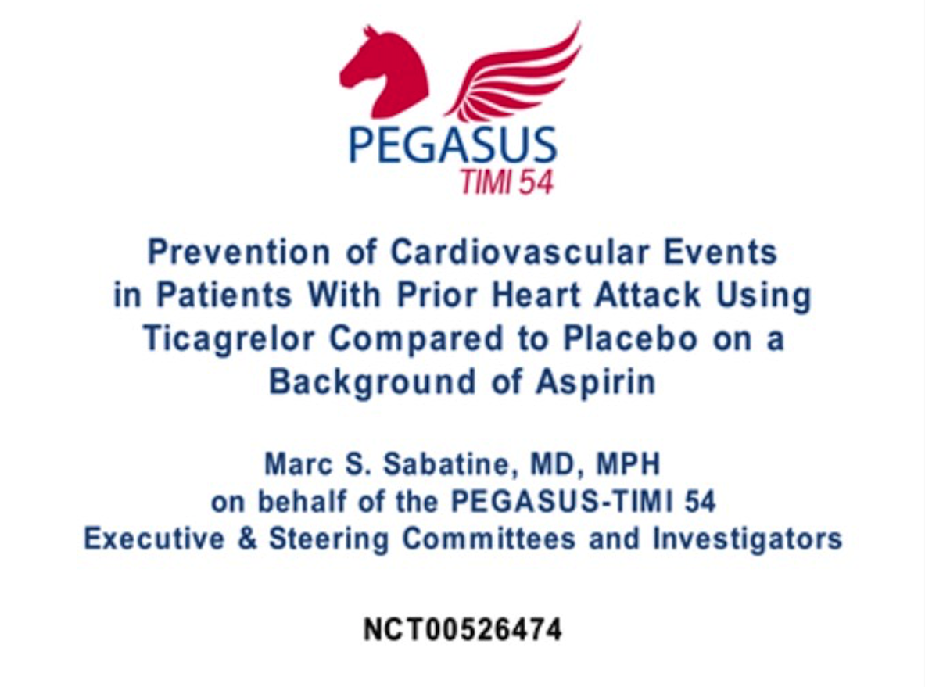

Slide 4
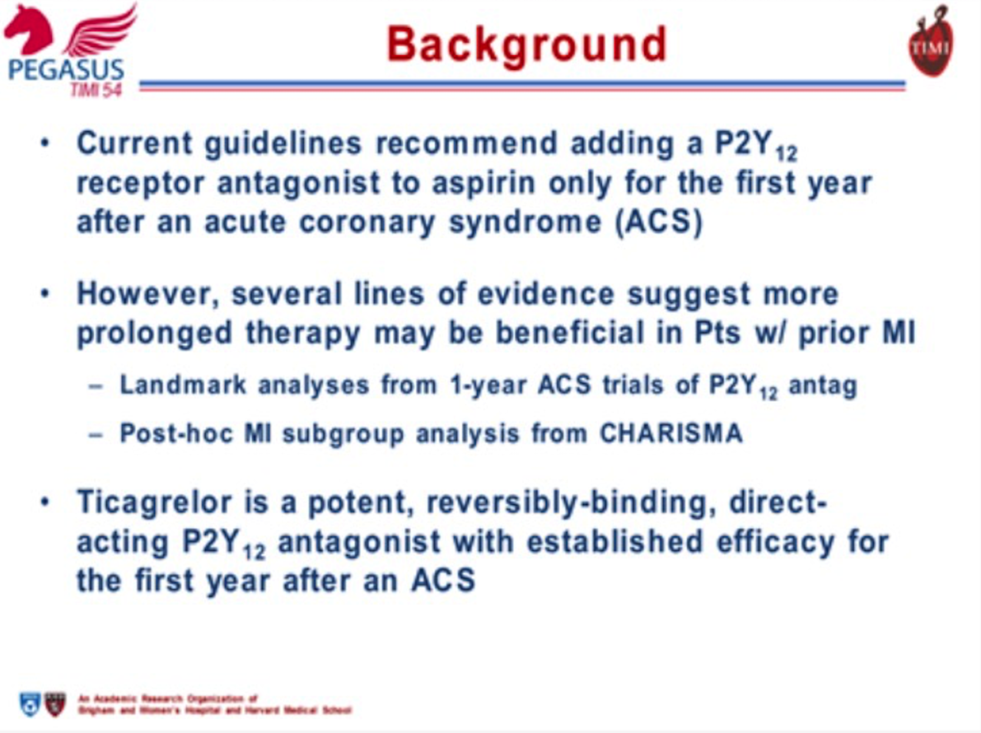

Slide 5
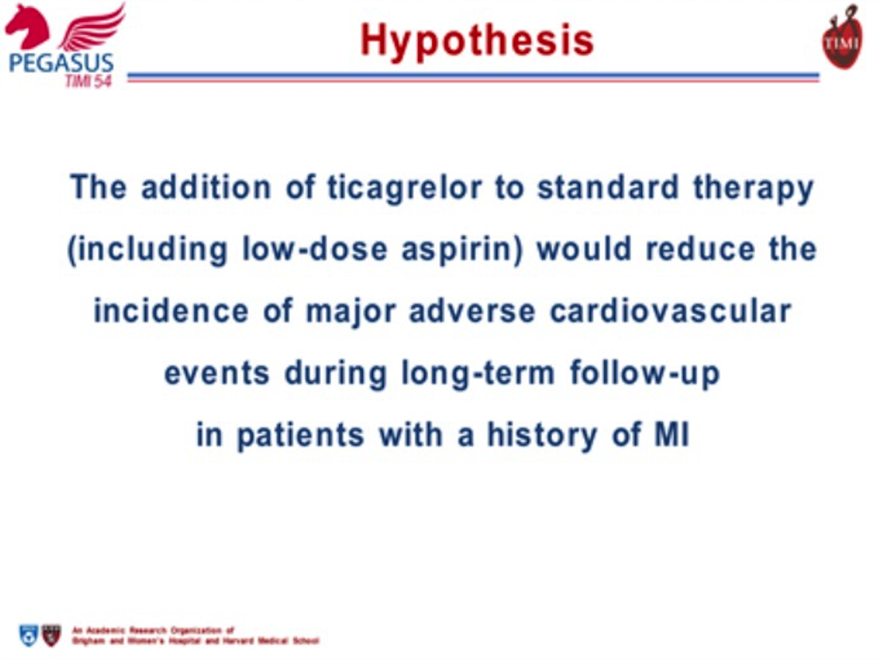

Slide 6
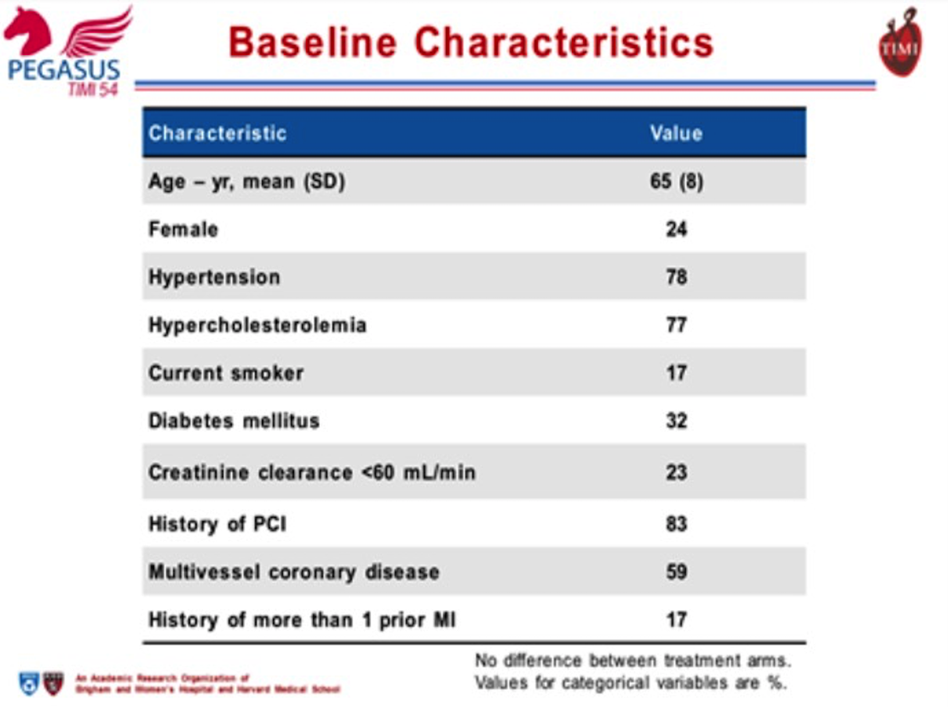

Slide 7
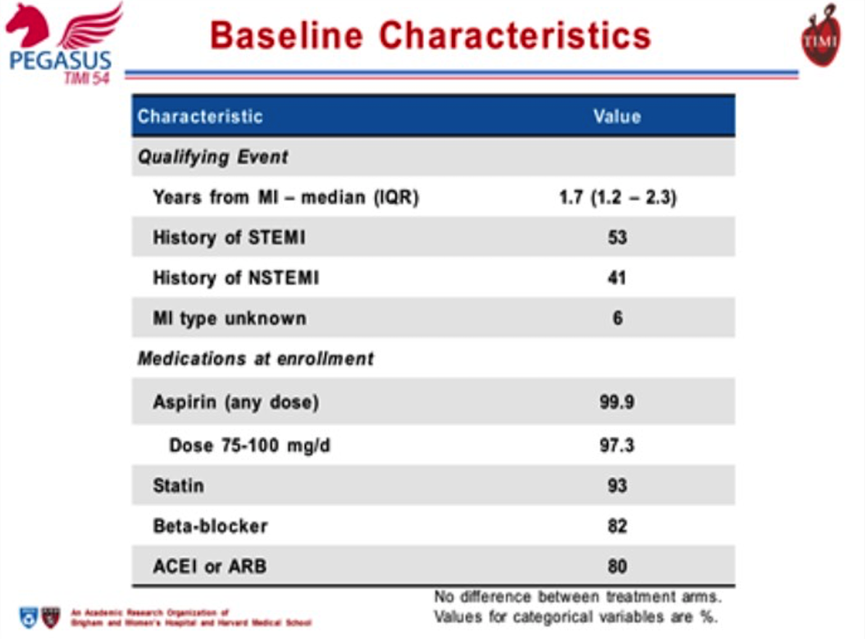

Slide 8
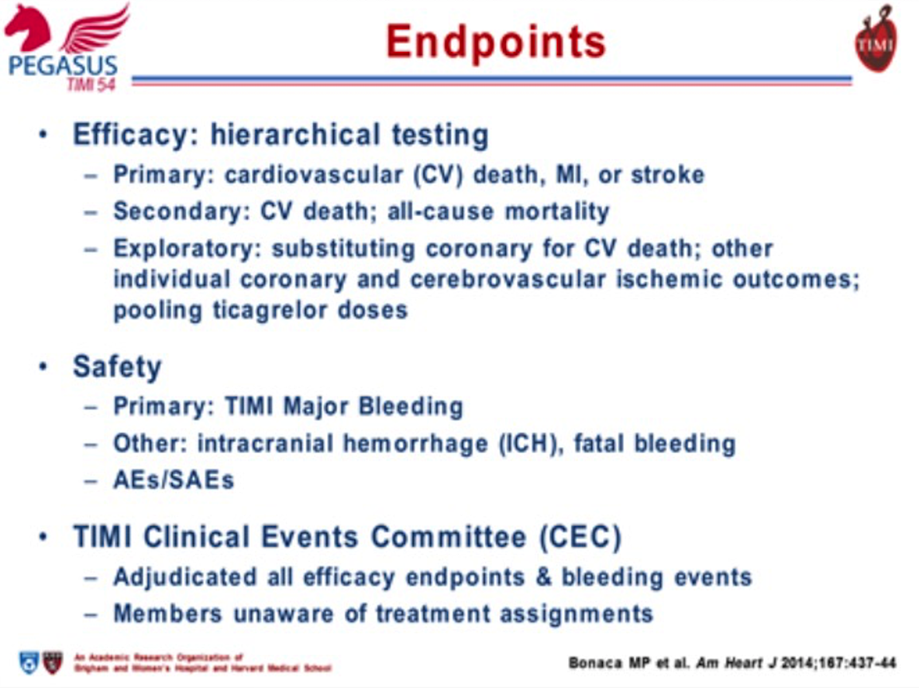

Slide 9
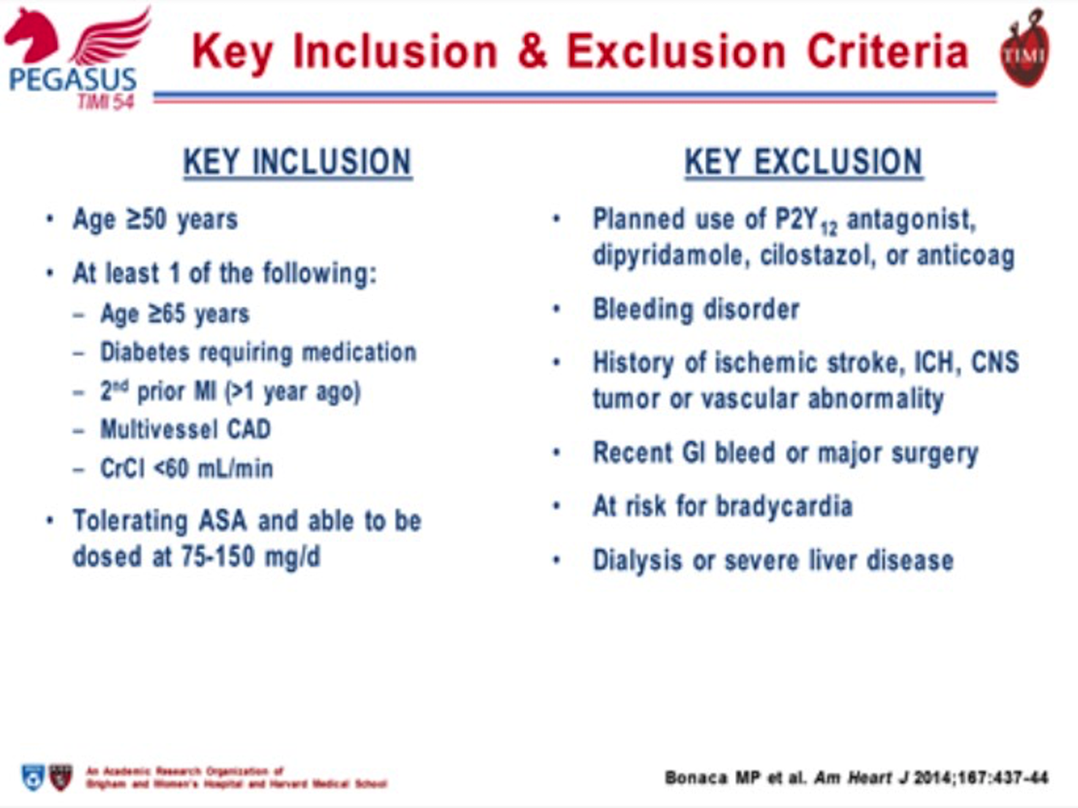

Slide 10
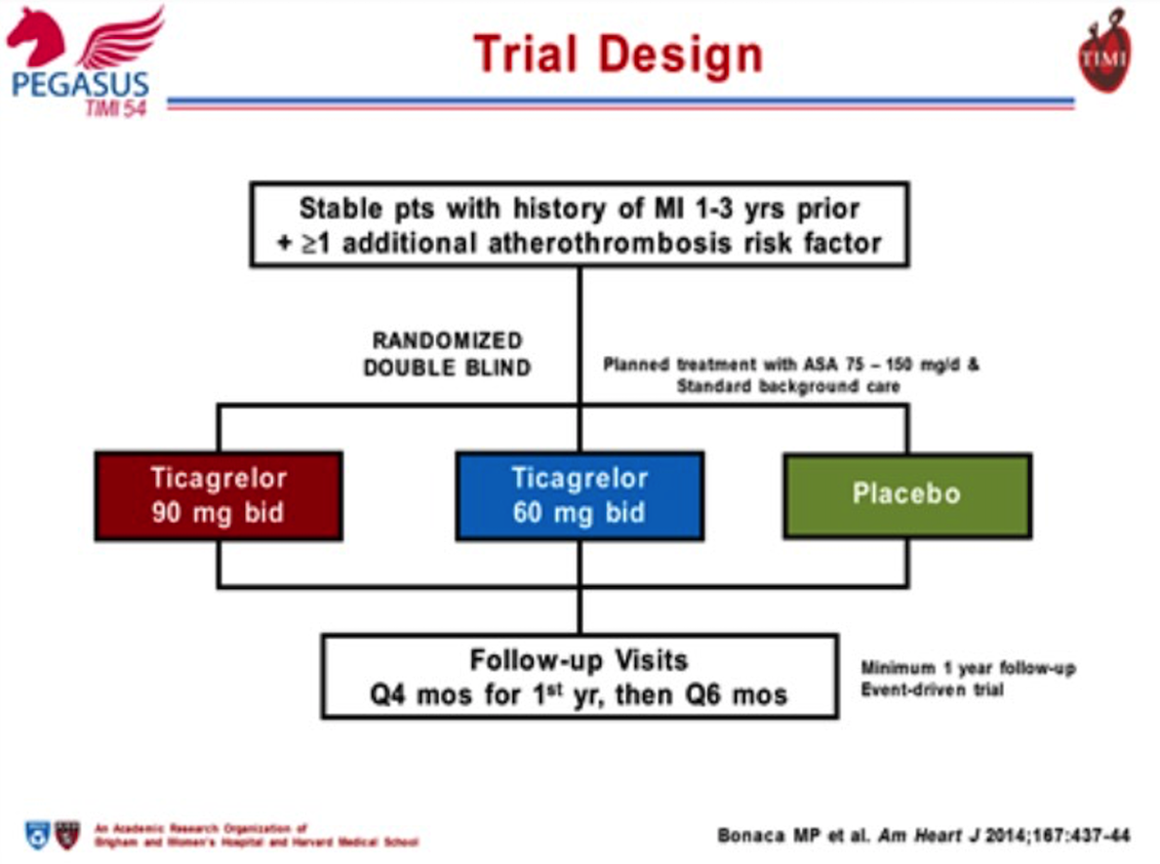

Slide 11
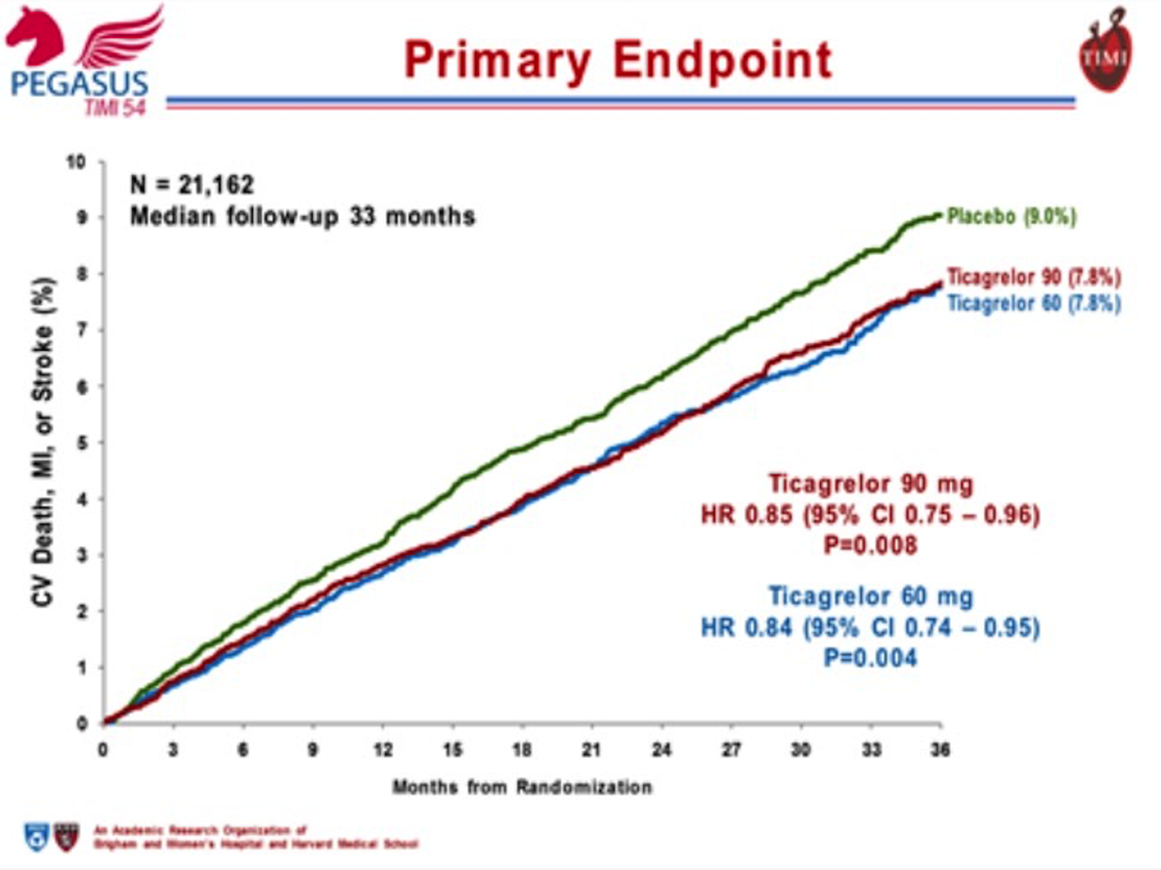

Slide 12
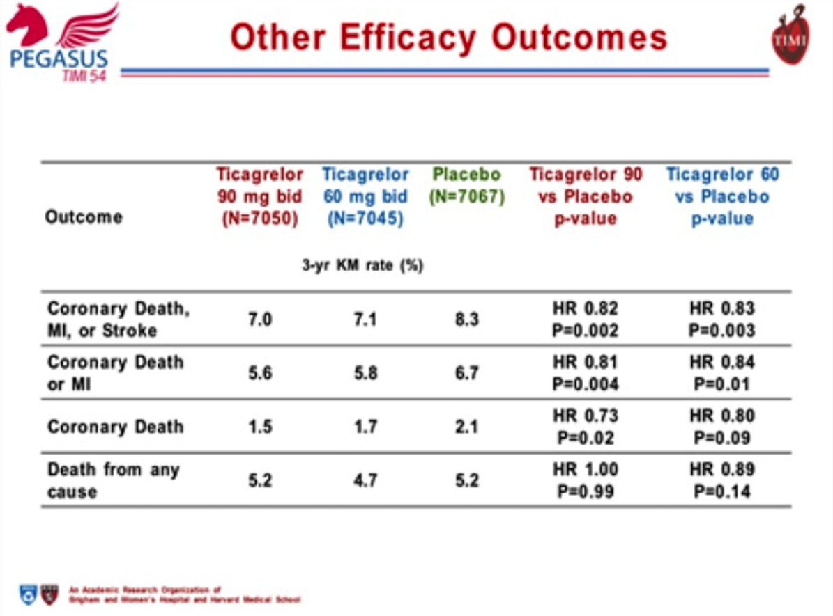

Slide 13
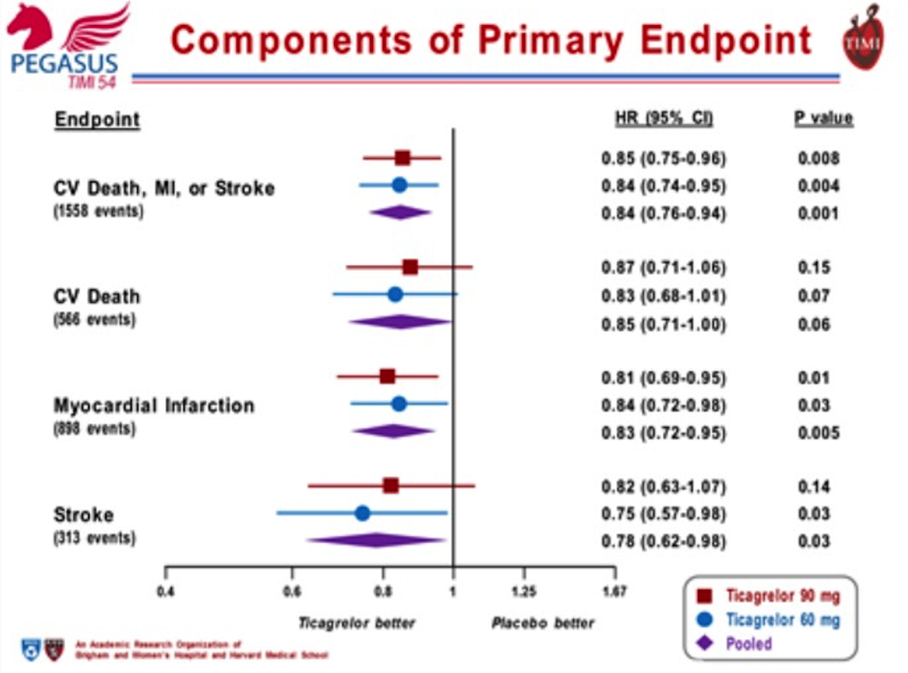

Slide 14
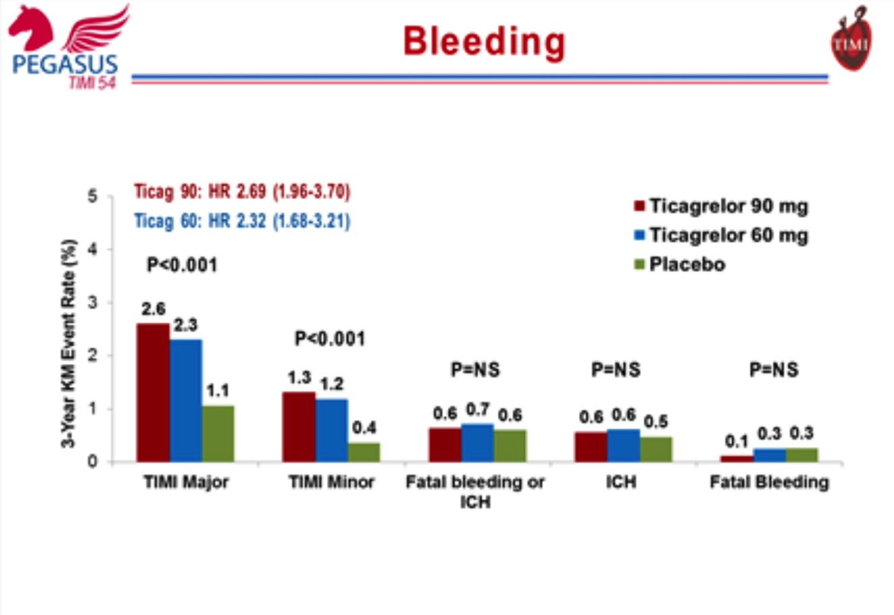

Slide 15
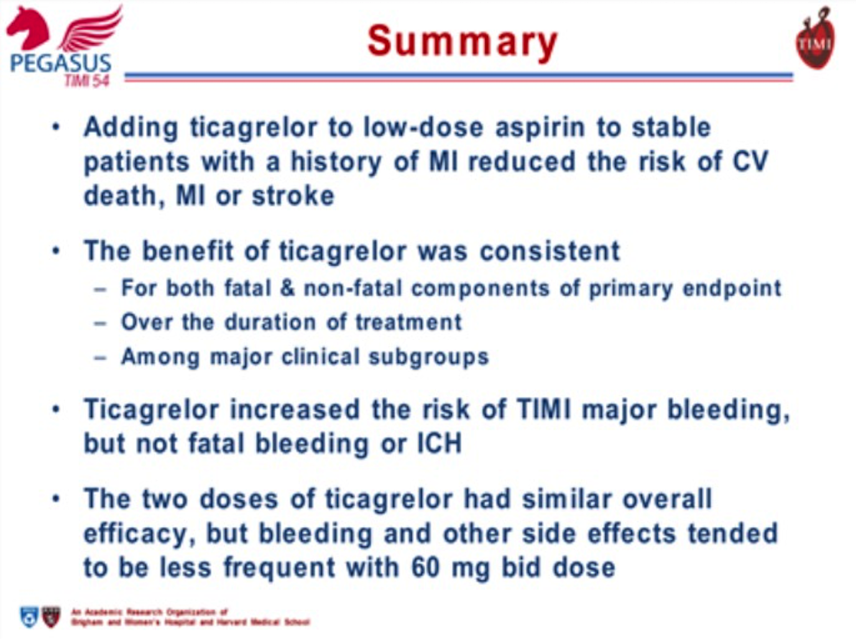

Slide 16
Five-Year Outcomes after Randomization to Transcatheter or Surgical Aortic Valve Replacement: Final Results of The PARTNER 1 Trial
Michael J. Mack, MD
on behalf of The PARTNER Trial Investigators
ACC 2015 | San Diego | March 15, 2015

Slide 17
Study Flow
Randomized = 699 patients
Transfemoral
n = 492
TF = 492 (70%)
TA = 207 (30%)
Transapical
n = 207
TAVR (244)
SAVR (248)
TAVR (104)
SAVR (103)
5 Years
Alive = 81
Dead = 150
LTFU = 4
Withdrawal = 3
Censored* = 6
5 Years
Alive = 69
Dead = 142
LTFU = 10
Withdrawal = 19
Censored* = 8
5 Years
Alive = 21
Dead = 79
LTFU = 1
Withdrawal = 1
Censored* = 2
5 Years
Alive = 33
Dead = 56
LTFU = 2
Withdrawal = 11
Censored* = 1
Follow-up Compliance
Follow-up Compliance
98.3%
95.6%
99.0%
97.8%
* Censored = Patient alive at last contact but no information available within FU window
Notes:
Compliance with withdrawals removed from computation.

Slide 18
Baseline Patient Characteristics
Demographics
Characteristic | TAVR (n=348) |  | SAVR (n=351)
 | n |  | n
Age – years (Mean ± SD) | 348 | 83.6 ± 6.8 | 349 | 84.5 ± 6.4
Male | 201 | 57.8% | 198 | 56.7%
NYHA Class III or IV | 328 | 94.3% | 328 | 94.0%
Previous CABG | 148 | 42.5% | 152 | 43.6%
Cerebrovascular disease | 96 | 29.4% | 87 | 26.8%
Peripheral vascular disease | 149 | 43.2% | 142 | 41.6%
STS Score (Mean ± SD) | 347 | 11.8 ± 3.3 | 349 | 11.7 ± 3.5

Slide 19
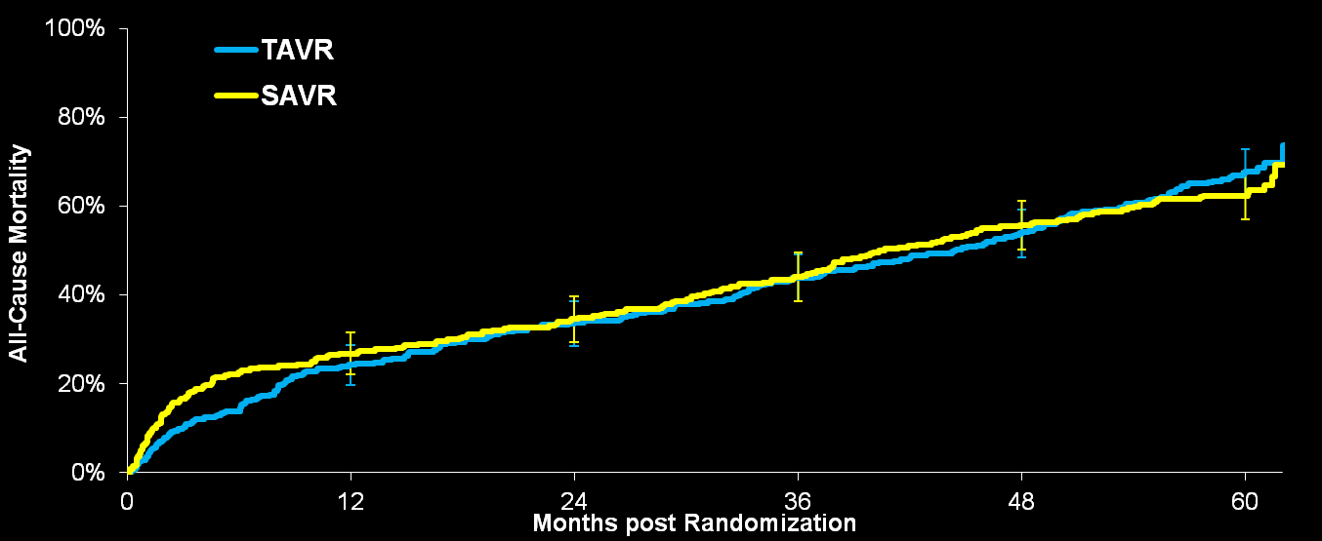
All-Cause Mortality (ITT)
All Patients
  HR [95% CI] =
  1.04 [0.86, 1.24]
  p (log rank) = 0.76
67.8%
62.4%
Error Bars Represent 95% Confidence Limits
No. at Risk
TAVR | 348 | 262 | 228 | 191 | 154 | 61
SAVR | 351 | 236 | 210 | 174 | 131 | 64

Slide 20
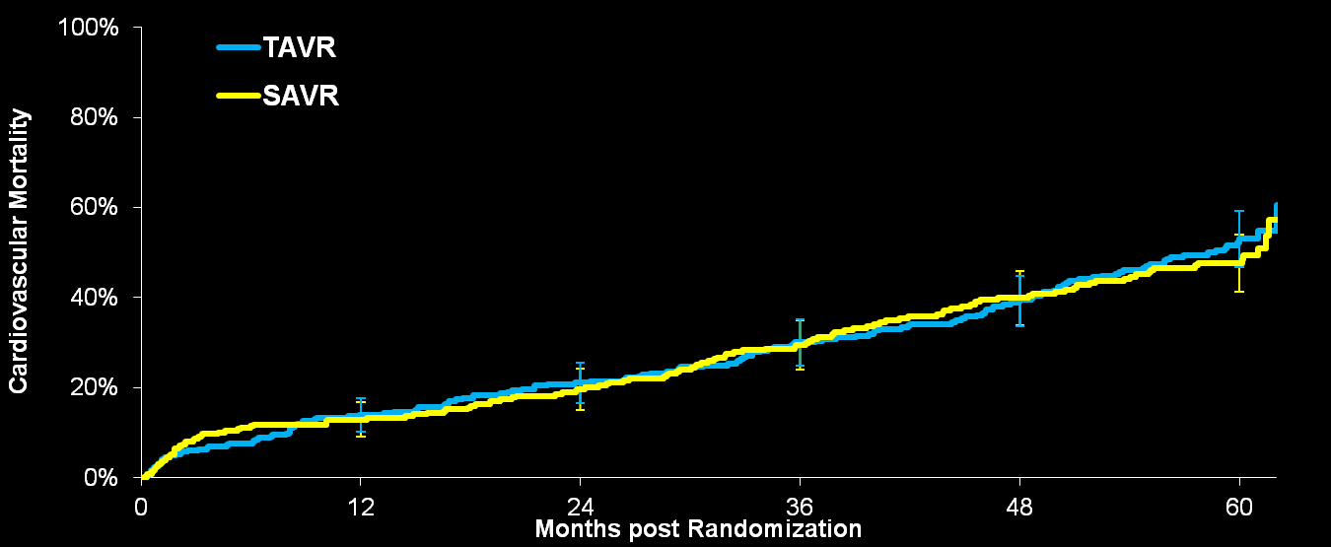
Cardiovascular Mortality (ITT)
All Patients
  HR [95% CI] =
  1.05 [0.83, 1.33]
  p (log rank) = 0.67
53.1%
47.6%
Error Bars Represent 95% Confidence Limits
No. at Risk
TAVR | 348 | 262 | 228 | 191 | 154 | 61
SAVR | 351 | 236 | 210 | 174 | 131 | 64

Slide 21

Median Survival
All Patients
40.6 Months
  p (log rank) = 0.76
44.5 Months
Months
Notes:
Trial p-value. Non-comparative.

Slide 22
Multivariate Baseline Predictors of Mortality (ITT) – All Patients
Predictor | Hazard Ratio [95% CI] | p-value
Assignment to TAVR | 1.09 [0.90-1.31] | 0.39
Body-Mass Index | 0.96 [0.94-0.98] | <0.001
Creatinine Level | 1.41 [1.17-1.71] | <0.001
Liver Disease | 2.31 [1.41-3.78] | <0.001
Mean Gradient (Per Increase 10 mm Hg) | 0.91 [0.85-0.97] | 0.004
Atrial Fibrillation | 1.37 [1.10-1.69] | 0.004

Slide 23
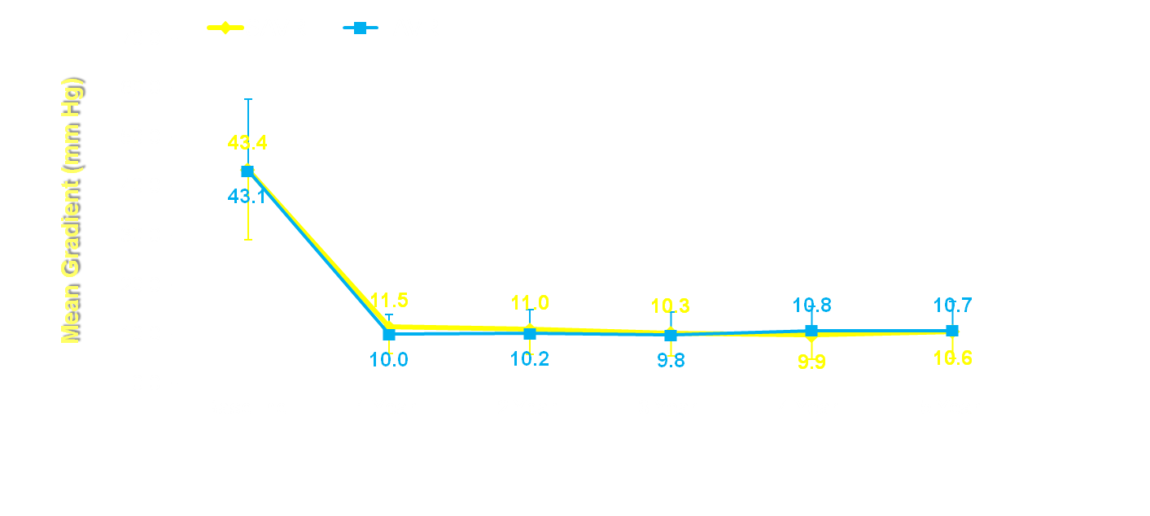
Aortic Valve Mean Gradient
  p < 0.0001
  Error Bars = ± 1 Std Dev
No structural valve deterioration that required re-intervention.
TAVR | 310 | 219 | 156 | 106 | 79 | 56
SAVR | 299 | 158 | 123 | 86 | 61 | 48
Notes:
23

Slide 24
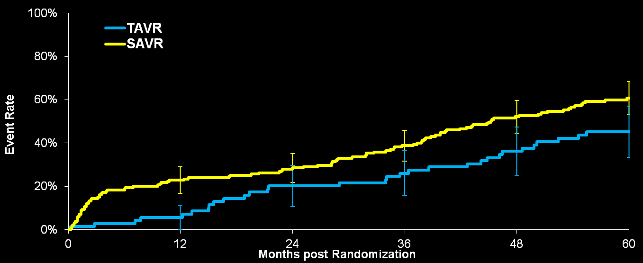
Mortality and None-Trace Total AR
Transfemoral Patients
  HR [95% CI] =
  0.64 [0.43, 0.95]
  p (log rank) = 0.03
60.9%
45.2%
Error Bars Represent 95% Confidence Limits
No. at Risk
TAVR | 70 | 65 | 55 | 51 | 43 | 19
SAVR | 181 | 137 | 126 | 105 | 78 | 36

Slide 25
Summary
At five years in The PARTNER 1A Trial of high surgical risk patients with severe aortic stenosis randomized to TAVR or SAVR there was no significant difference in:
  All-Cause and Cardiovascular Mortality
  Strokes
  NYHA Class
  Rehospitalization
  Valve Hemodynamics
No structural valve deterioration requiring re-intervention in TAVR patients.
The presence of ≥ mild paravalvular leak is associated with decreased survival.

Slide 26
Clinical and Echocardiographic Outcomes at 30 Days with the SAPIEN 3 TAVR System in Inoperable, High-Risk and Intermediate-Risk AS Patients
Susheel Kodali, MD
on behalf of The PARTNER Trial Investigators
ACC 2015 | San Diego | March 15, 2015

Slide 27
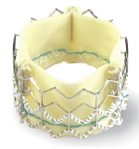
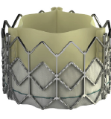
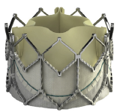
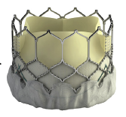
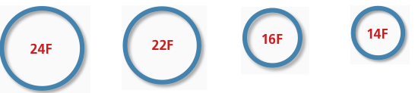
Evolution of the Edwards Balloon-Expandable Transcatheter Valves
Cribier-Edwards
SAPIEN
SAPIEN XT
SAPIEN 3
2002
2006
2009
2013
* Sheath compatibility for a 23 mm valve

Slide 28
The PARTNER II S3 Trial
Study Design
Symptomatic Severe Aortic Stenosis
ASSESSMENT by Heart Valve Team
SAPIEN 3
Intermediate Risk Operable
(PII S3i)
High Risk Operable / Inoperable
(PII S3HR)
n = 1076 Patients
n = 583
Patients
2 Single Arm Non-Randomized
Historical-Controlled Studies
ASSESSMENT: Optimal Valve Delivery Access
ASSESSMENT: Optimal Valve Delivery Access
PII A
SAVR
PI A
SAPIEN
Transfemoral (TF)
Transapical /
Transaortic (TA/TAo)
Transfemoral (TF)
Transapical /
Transaortic (TA/TAo)
TF TAVR
SAPIEN 3
TAA TAVR
SAPIEN 3
TF TAVR
SAPIEN 3
TAA TAVR
SAPIEN 3

Slide 29
Study Flow: S3HR & S3i
30 Day Patient Status
S3HR
S3i
n = 583
n = 1076
13 Deaths
12 Deaths
n = 570
SAPIEN 3
n = 1064
SAPIEN 3
0 Withdrawal
3 LTFU
0 Withdrawal
5 LTFU
567 / 570 or 99.5% follow-up
visits performed at 30 Days
1059 / 1064 or 99.5% follow-up
visits performed at 30 Days

Slide 30
Baseline Patient Characteristics
Demographics
Characteristic (%) | S3HR (n=583) | S3i (n=1076)
NYHA Class III or IV | 90.1 | 72.6
Previous CABG | 33.1 | 28.0
Previous CVA | 11.0 | 8.9
Peripheral Vascular Disease | 35.2 | 28.3
Diabetes | 34.5 | 34.1
COPD - O₂ Dependent | 11.7 | 5.0
CKD - Creat. ≥ 2mg/dL | 12.0 | 7.5
Atrial Fibrillation | 43.7 | 36.0
Permanent Pacemaker | 16.3 | 13.2
Frailty | 30.9 | 8.6

Slide 31
Baseline Echocardiography
Characteristic | S3HR (n=583) | S3i (n=1076)
AV Area - cm² (mean ± SD) | 0.67 ± 0.18 | 0.70 ± 0.17
Annulus Diam. - cm (mean ± SD) | 2.2 ± 0.2 | 2.2 ± 0.2
AV Gradient - mmHg (mean ± SD) | 45.5 ± 14.3 | 46.3 ± 12.7
LV Ejection Fraction (%) | 56.4 ± 14.8 | 58.6 ± 13.3
Mod-Severe MR (%) | 3.0 | 2.3

Slide 32
Procedural Factors
 | S3HR (n=583) | S3i (n=1076)
Post-Dilatation (%) | 14.8 | 11.3
>1 Valve Implanted (%) | 0.9 | 0.4
Valve Embolization (%) | 0.2 | 0.1
IABP During Procedure (%) | 0.5 | 0.4
Cardiopulmonary Bypass (%) | 1.2 | 0.6
Conscious Sedation (%) | 13 | 17
Median LOS – Days (Min, Max) | 5 (1, 33) | 4 (1, 64)

Slide 33
Mortality and Stroke: S3HR
At 30 Days (As Treated Patients)
Mortality
Stroke
%
O:E = 0.26
(STS 8.6%)
%

Slide 34
Mortality and Stroke: S3i
At 30 Days (As Treated Patients)
Mortality
Stroke
%
O:E = 0.21
(STS 5.3%)
%

Slide 35

All-Cause Mortality at 30 Days
Edwards SAPIEN Valves (As Treated Patients)
PARTNER I and II Trials
Overall and TF Patients
175 | 344 | 240 | 271 | 282 | 583 | 491 | 1072 | 947
SAPIEN |  |  |  | SXT | SAPIEN 3

Slide 36

All Strokes at 30 Days
Edwards SAPIEN Valves
PARTNER I and II Trials
Neurologist evaluations (pre- and post)
SAPIEN | SAPIEN XT | SAPIEN 3

Slide 37
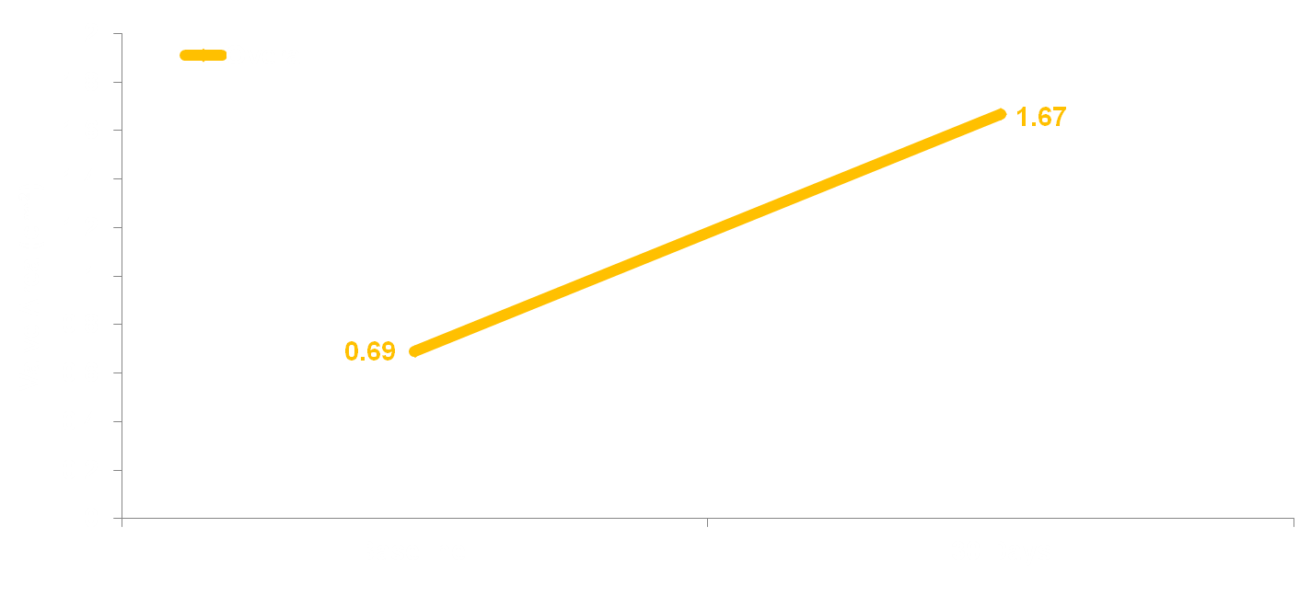
Echo Findings: S3HR & S3i
Aortic Valve Area (Valve Implant Patients)
No. of Echos
Overall | 1546 |  | 1461

Slide 38
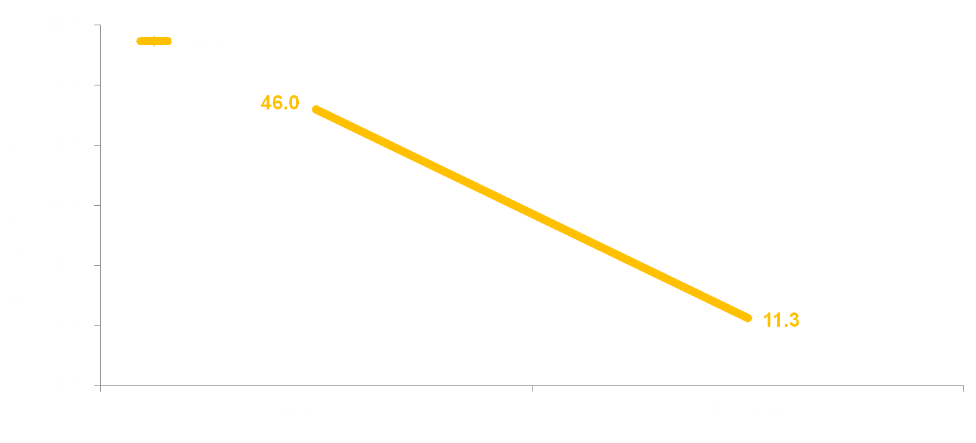
Echo Findings: S3HR & S3i
Mean Gradients (Valve Implant Patients)
No. of Echos
Overall | 1602 |  | 1531

Slide 39
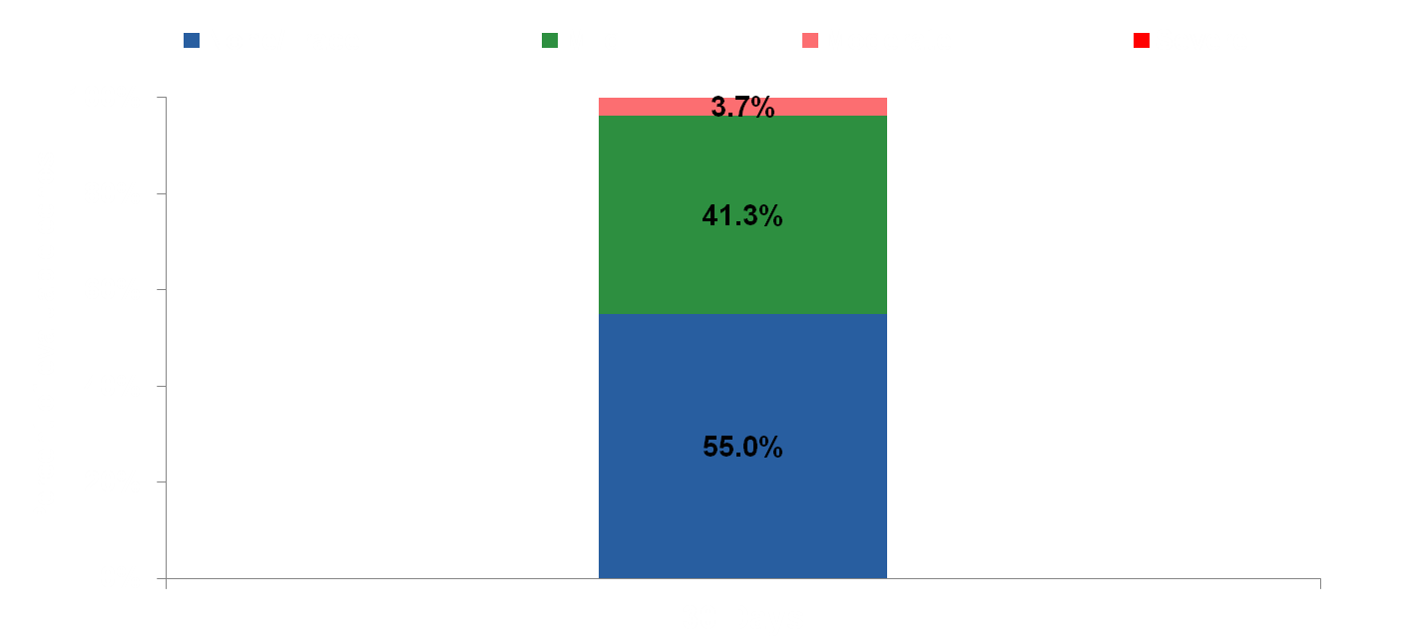
Paravalvular Leak: S3HR & S3i
(Valve Implant Patients)
0.1%
No. of Echos
1504

Slide 40

Moderate/Severe PVL at 30 Days
Edwards SAPIEN Valves
PARTNER I and II Trials
SAPIEN | SAPIEN XT | SAPIEN 3

Slide 41
Conclusions (1)
In high-risk and inoperable patients (S3HR), the SAPIEN 3 TAVR system demonstrated low mortality and stroke and excellent clinical outcomes at 30 days:
    Mortality: 2.2% (TF 1.6%, TA/TAo 5.4%)
    Disabling Stroke: 0.9%
In intermediate-risk patients (S3i), SAPIEN 3 was associated with strikingly low mortality and strokes at 30 days:
    Mortality: 1.1% (TF 1.1%, TA/TAo 1.6%)
    Disabling Stroke: 1.0%

Slide 42
Conclusions (2)
Other important clinical findings with SAPIEN 3
(both S3HR & S3i) include:
    Major vascular complications: ~5%
    Annular rupture: ~0.2%
    Coronary obstruction: ~0.3%
    New pacemakers: ~10%
Significant paravalvular regurgitation with SAPIEN 3 (both S3HR & S3i) was rare:
    Severe: 0.1%
    Moderate: 3.7%

Slide 43
Implications
The rapid evolution of balloon-expandable TAVR, both procedural developments and technical enhancements, represented in the SAPIEN 3 clinical and echo results, indicates at least parity with the best surgical outcomes in comparable patients.
SAPIEN 3 TAVR should now be considered as an alternative to surgery, even in lower risk patients with aortic stenosis.

Slide 44
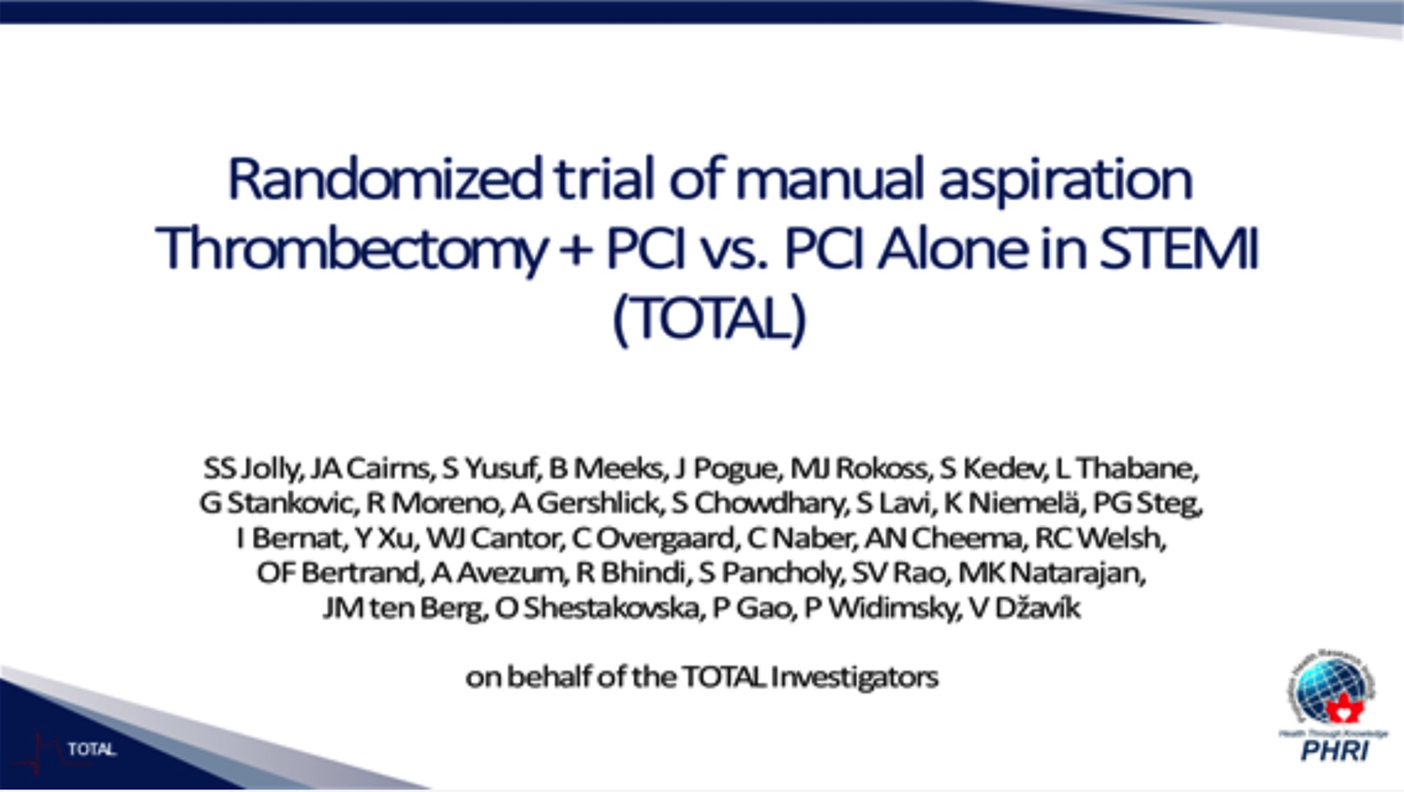

Slide 45
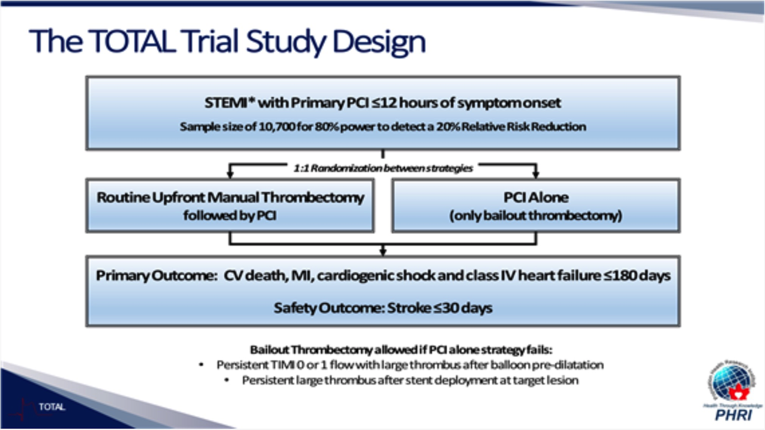

Slide 46
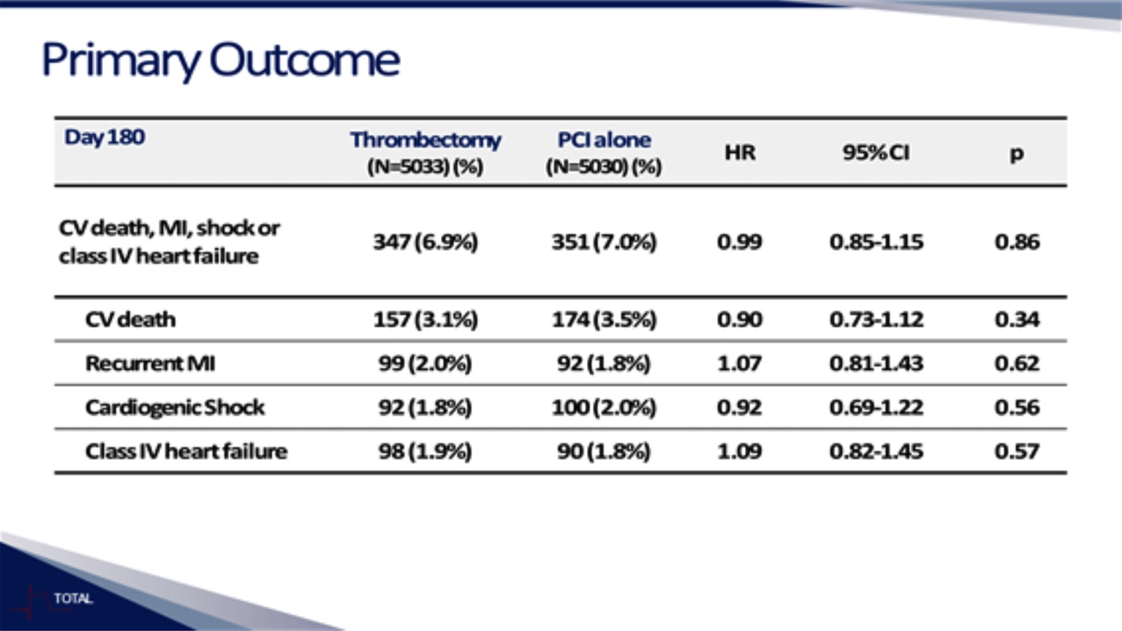

Slide 47
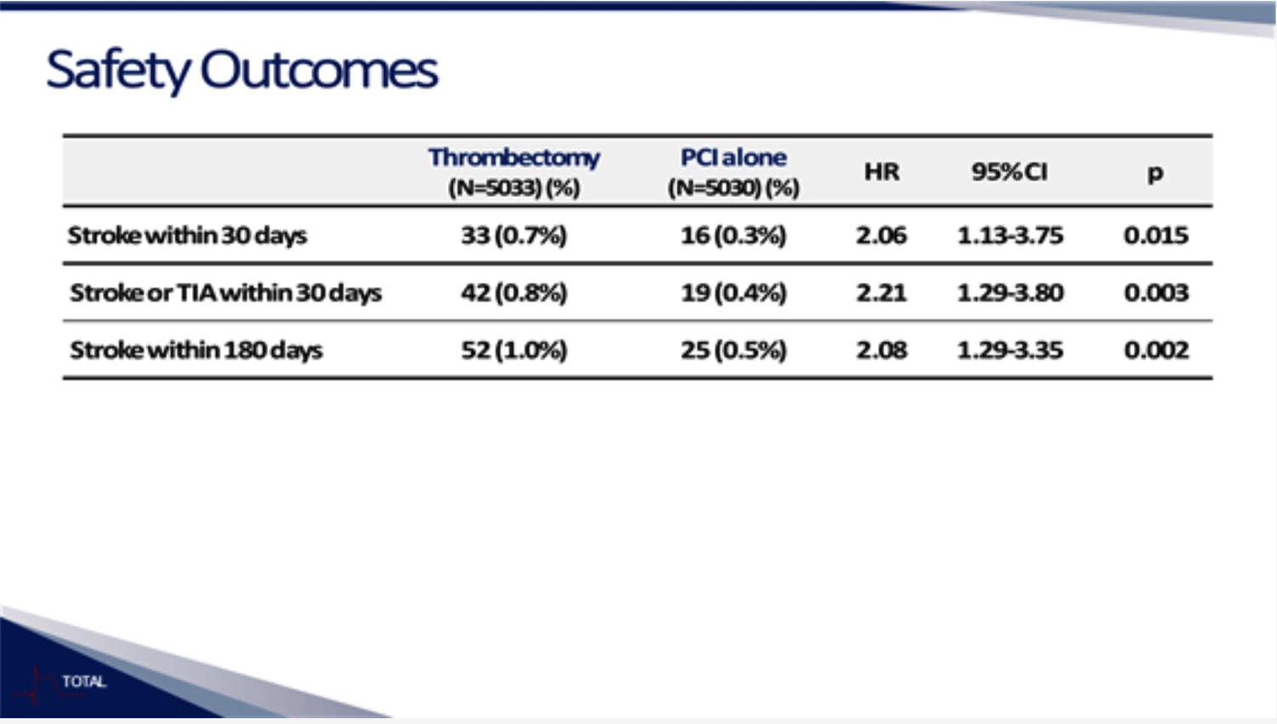

Slide 48
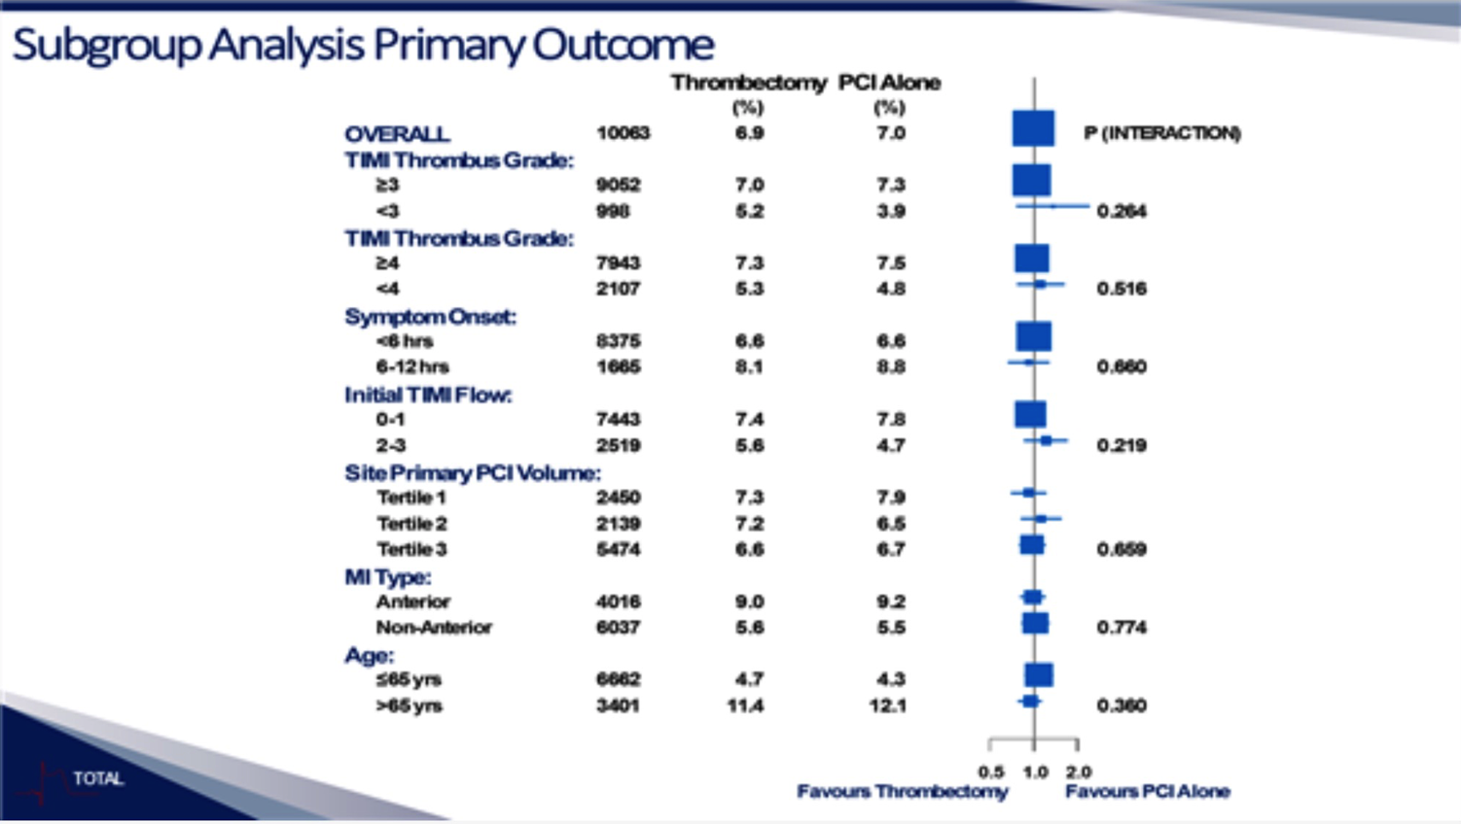

Slide 49
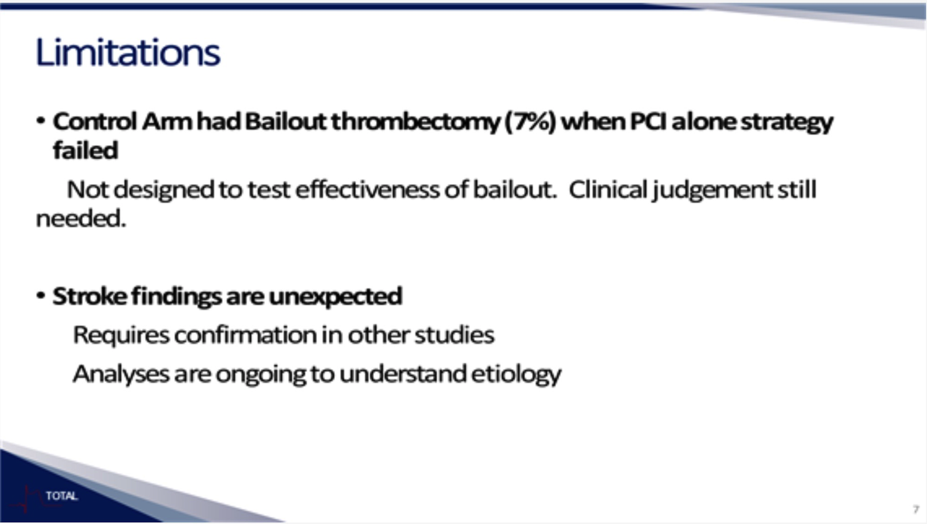

Slide 50
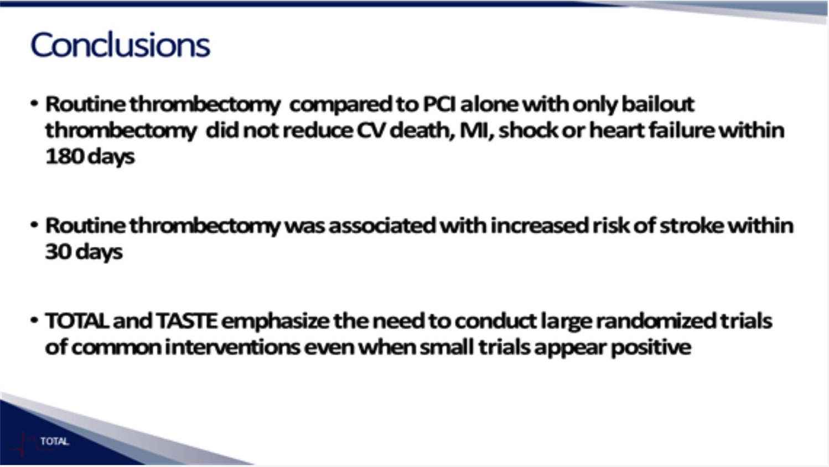

Slide 51
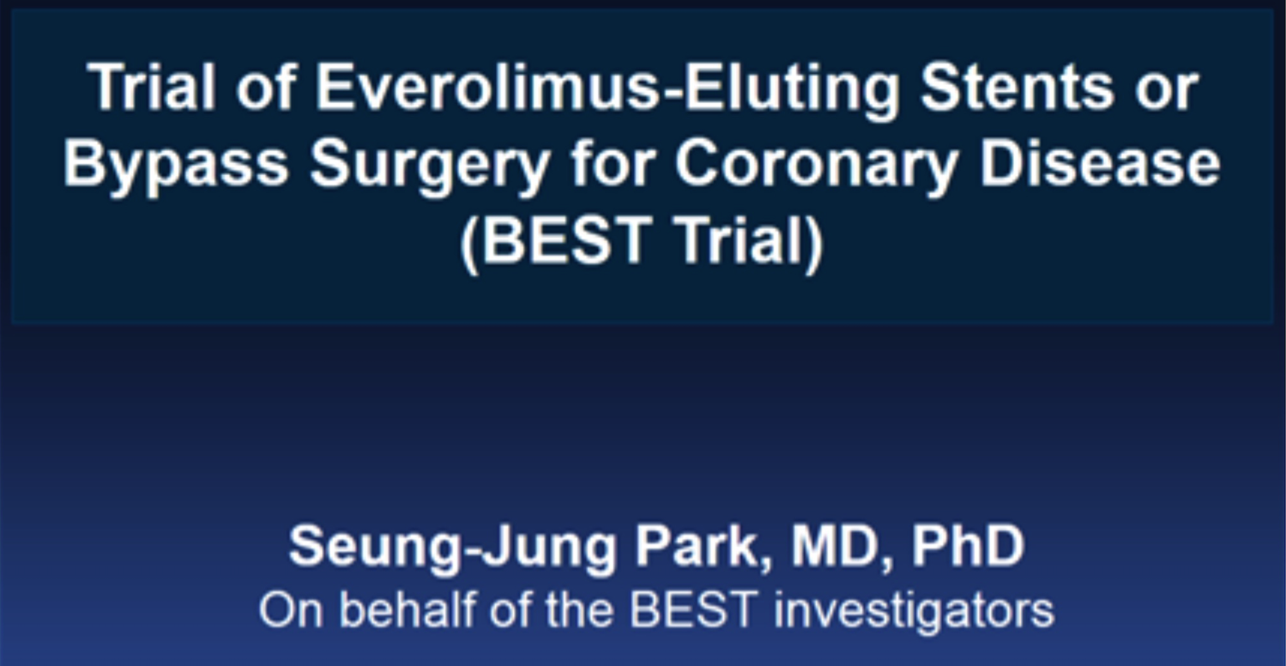

Slide 52
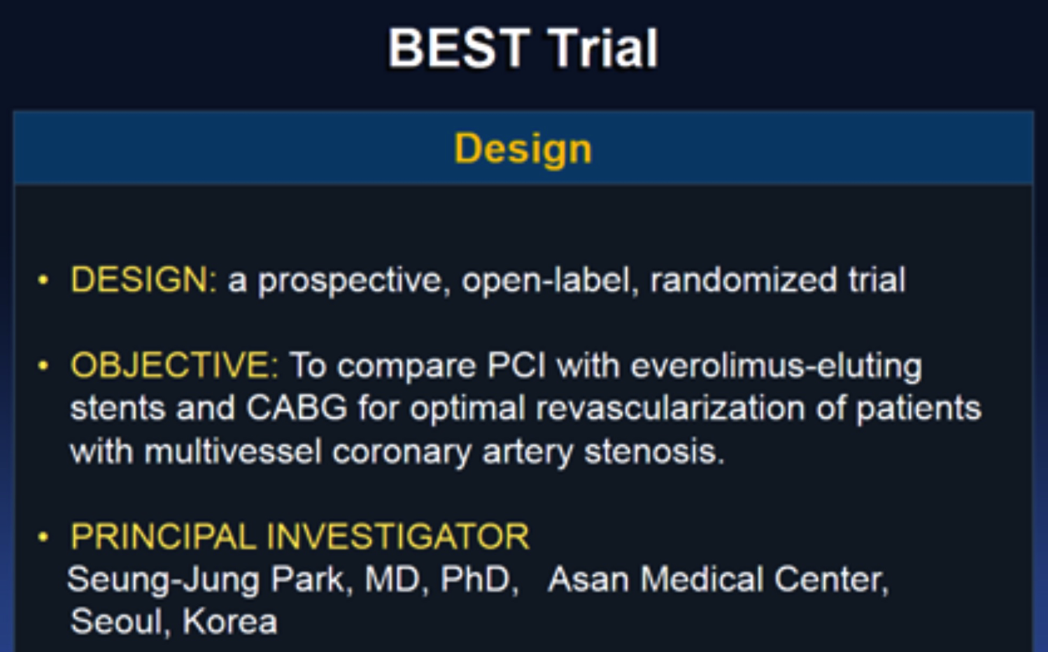

Slide 53
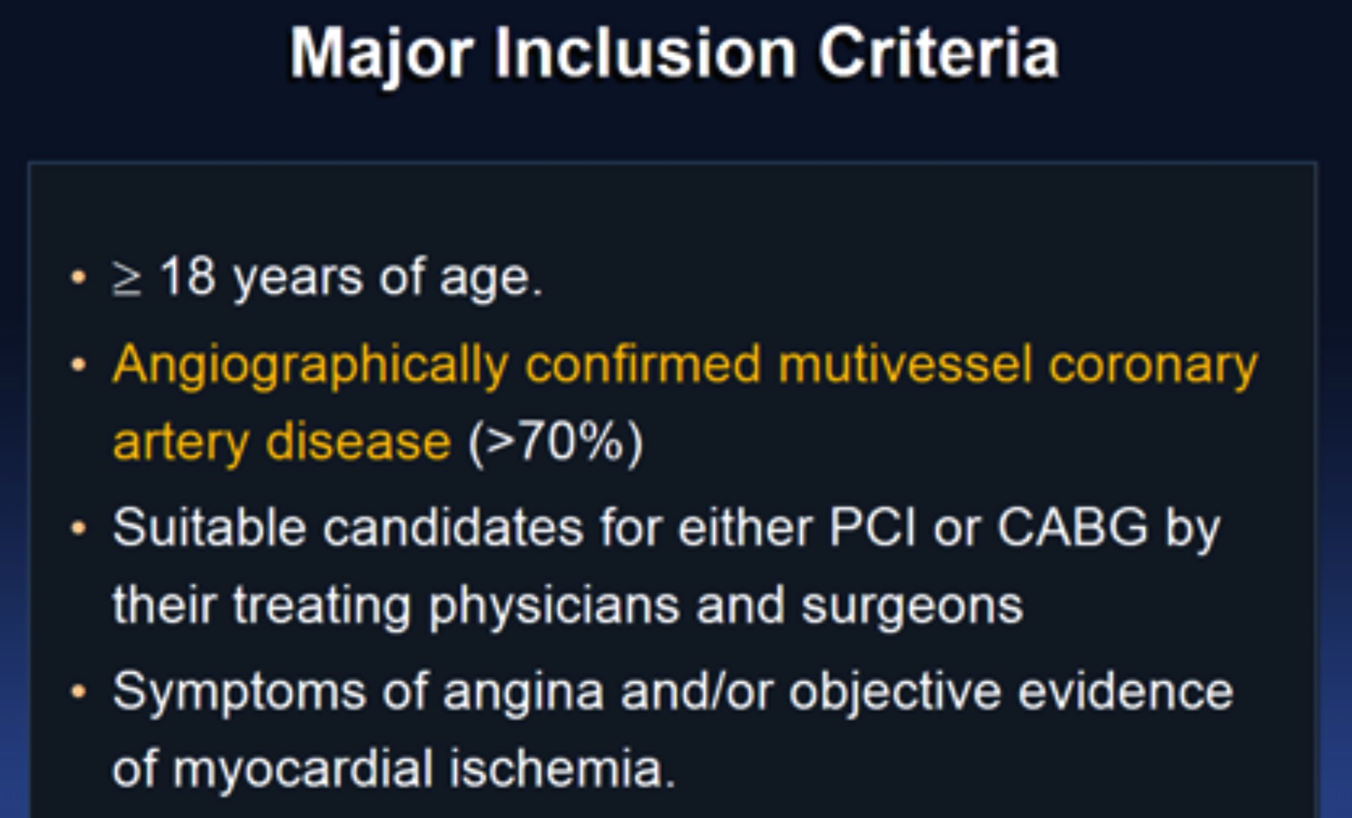

Slide 54
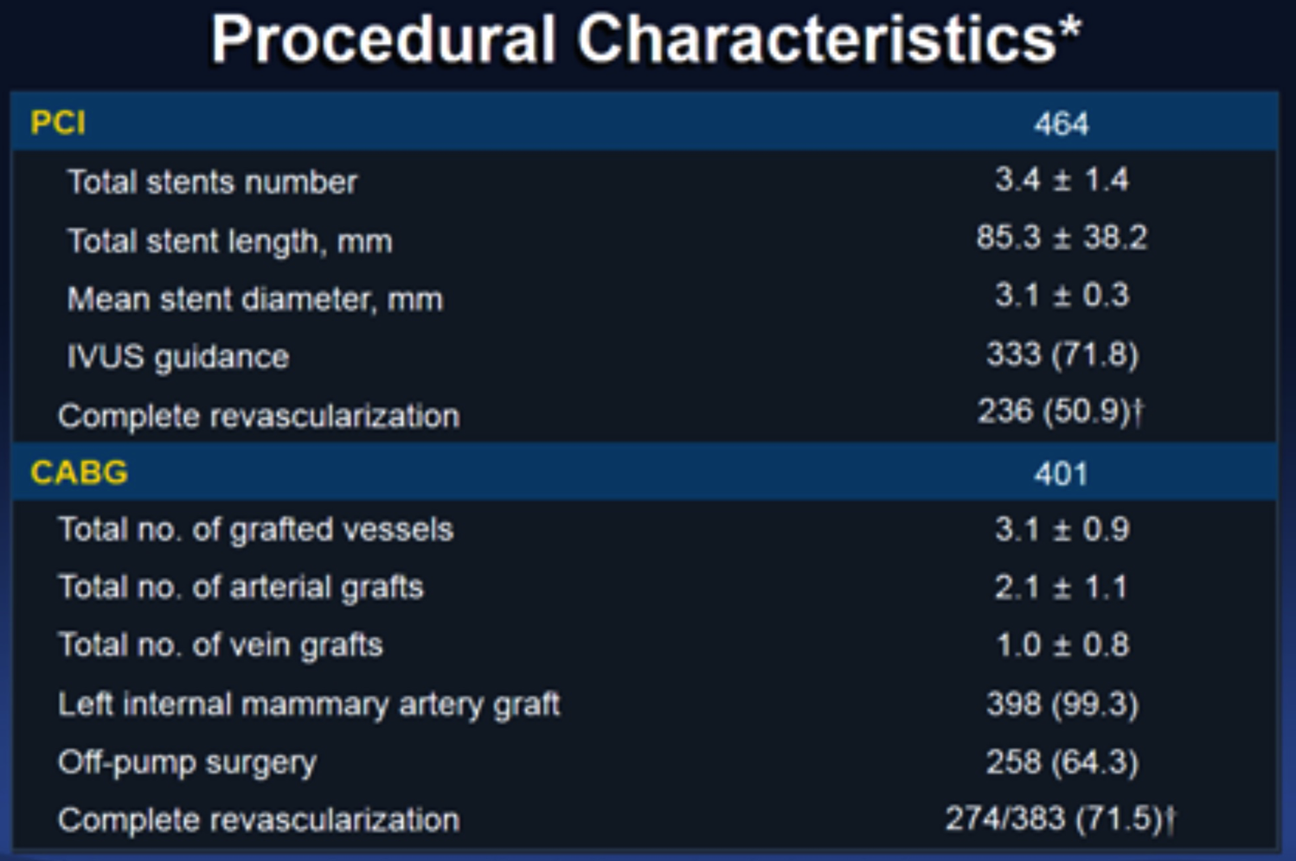

Slide 55
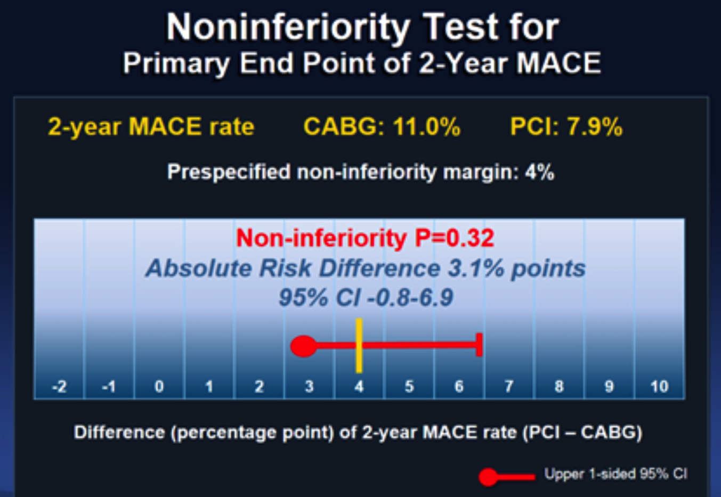

Slide 56
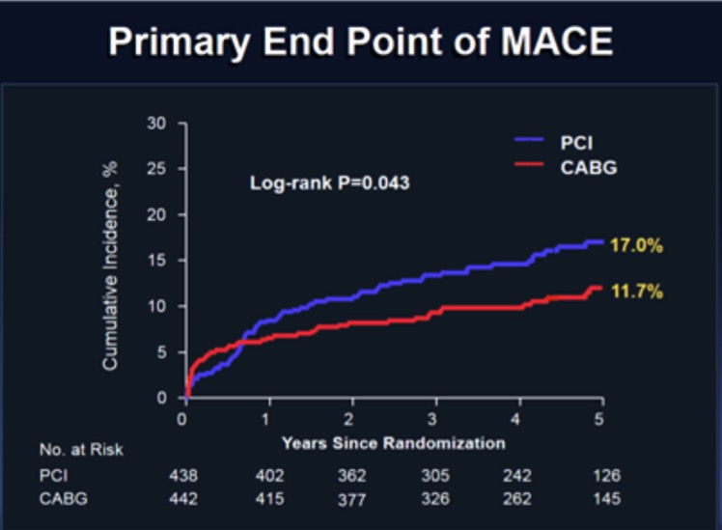
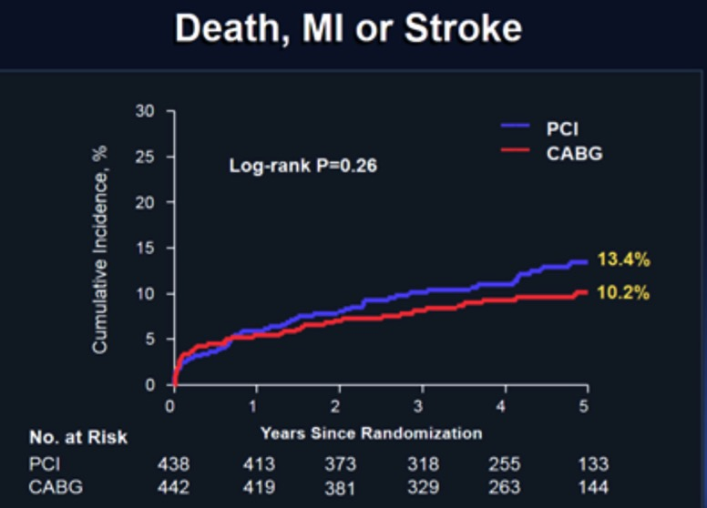

Slide 57
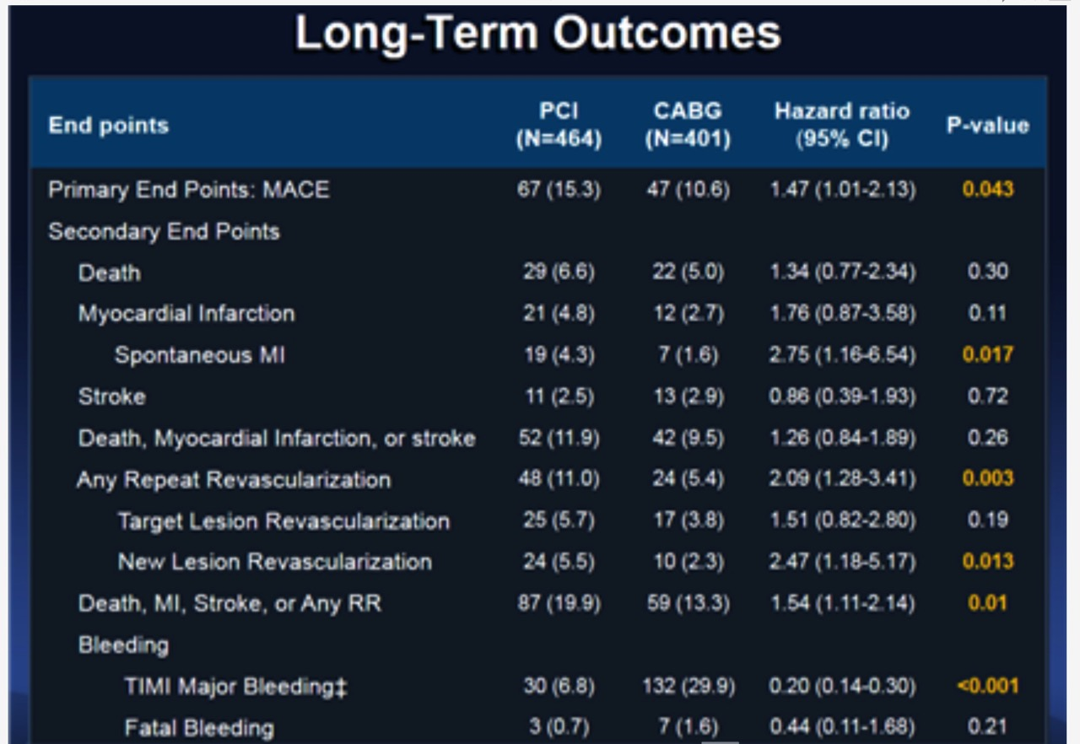

Slide 58
