Slide 1




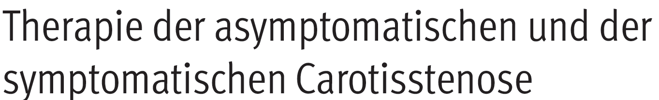
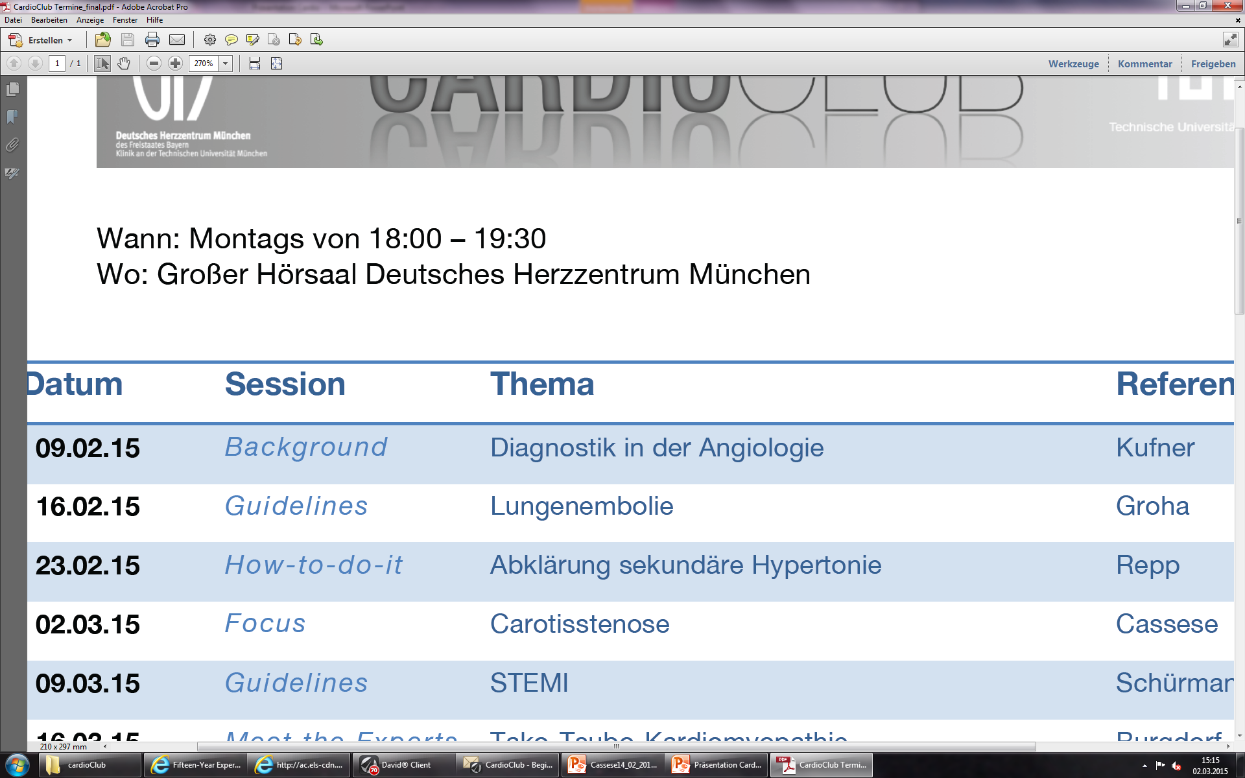
CARDIOCLUB

Slide 2
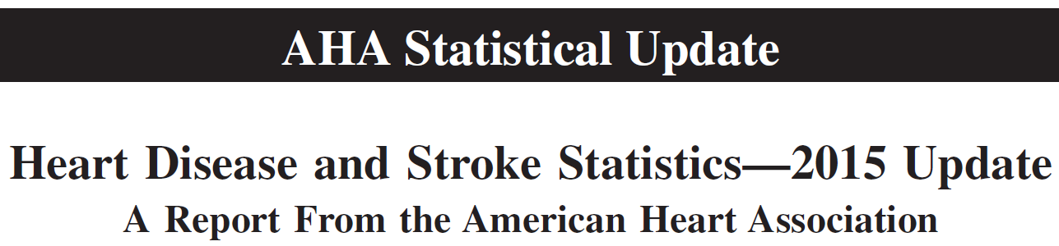

CARDIOCLUB
Epidemiology
A total of 795,000 people/year continue to experience a new or recurrent stroke (ischemic or haemorrhagic)
On average, every 40 seconds, someone in the US has a stroke and every 4 minutes someone dies of stroke-related complications
10 to 15% of all ischemic strokes originate from a stenosis at the level of internal carotid artery
Circulation. 2015;131:e29-e322

Slide 3
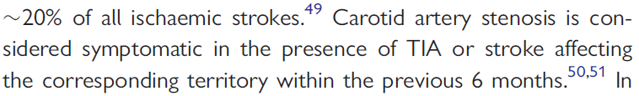
CARDIOCLUB
Diagnosis I.
Risk-profile for atherosclerotic disease (Bei Vorliegen vaskulärer Risikofaktoren ist ein Screening mit Ultraschall sinnvoll. Das Screening sollte auf solche Patienten beschränkt werden, bei denen im Falle eines positiven Ergebnisses eine Konsequenz erwächst - S3 Leitlinien Extracranielle Carotisstenose; Diagnostik, Therapie und Nachsorge, 2012)
Clinical signs and neurological symptoms (if any)
ESC PAD Guidelines. Eur Heart J. 2011 Nov;32(22):2851-906
Approximately 15% of all strokes are heralded by a TIA
Circulation. 2015;131:e29-e322

Slide 4
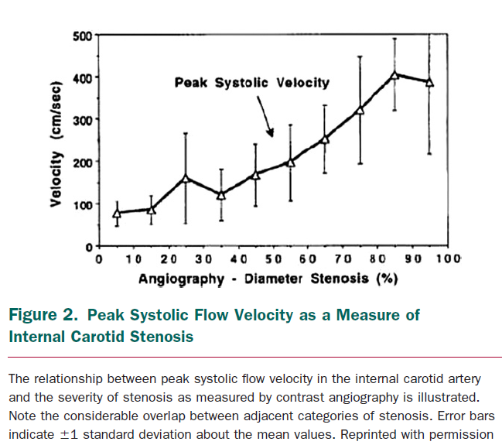
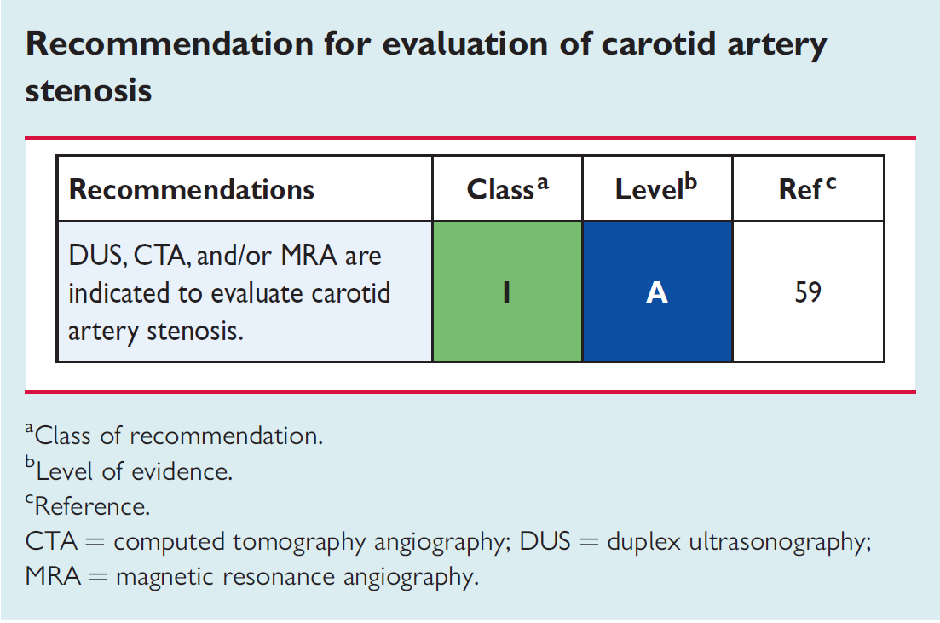
CARDIOCLUB
Diagnosis II.
Imaging
DUS is commonly used as the first step to detect extracranial carotid artery stenosis and to assess its severity. The peak systolic velocity (systolische Spitzengeschwindigkeit im Stenose maximum [cm/s]) measured in the internal carotid artery is the primary variable used for this purpose
ESC PAD Guidelines. Eur Heart J. 2011 Nov;32(22):2851-906
Radiology. 2000 Jan;214(1):247-52

Slide 5
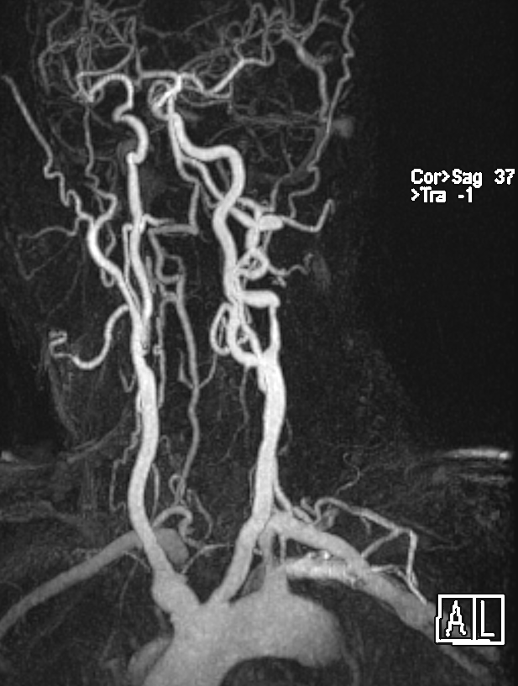
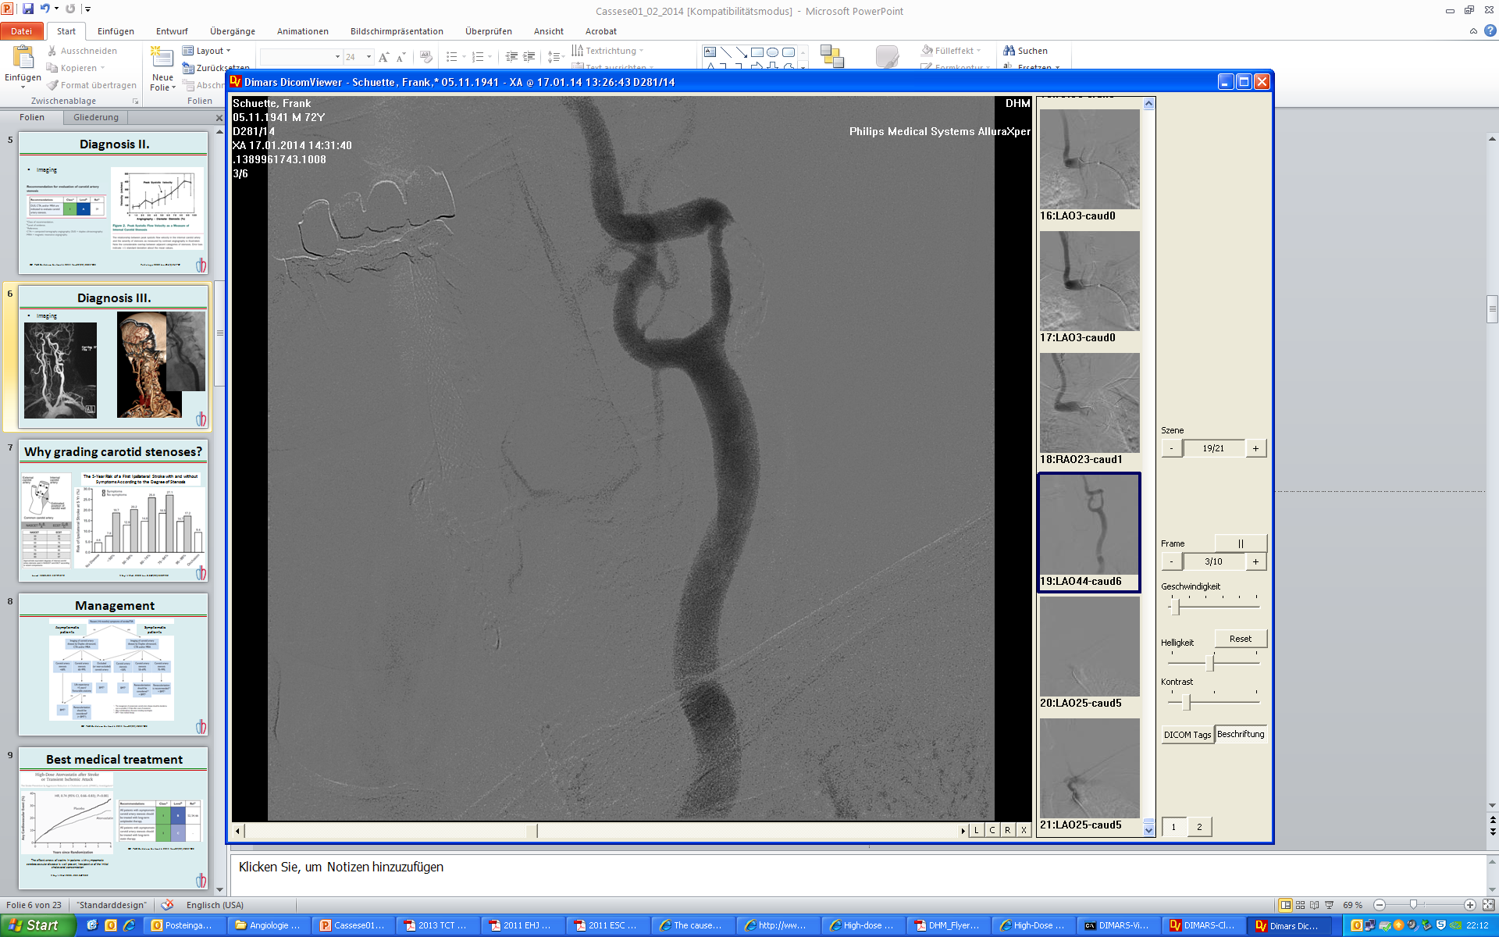
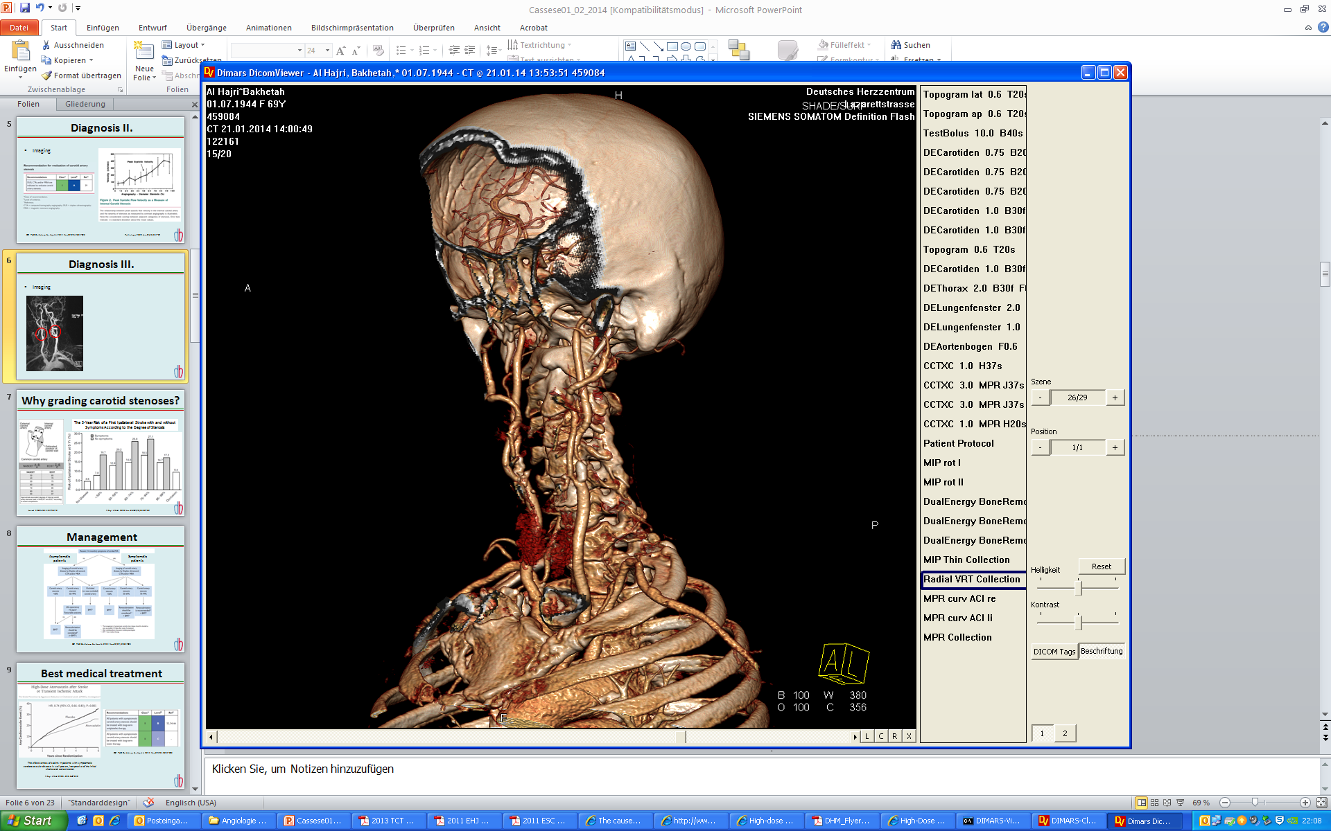
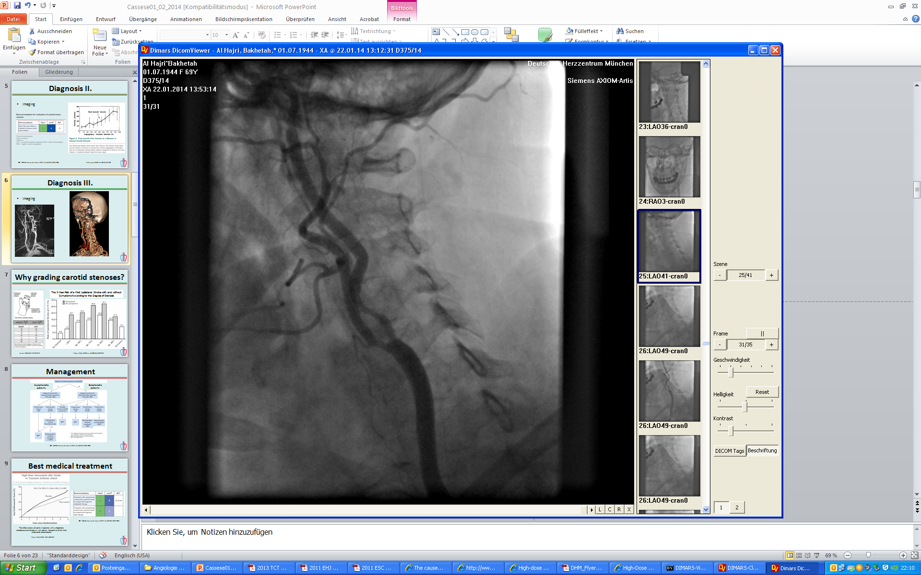
CARDIOCLUB
Diagnosis III.
Imaging
The advantages of MRA and CTA include the simultaneous imaging of the aortic arch, the common and internal carotid arteries in their totality, the intracranial circulation, as well as the brain parenchyma.
In order to improve the accuracy of the diagnosis, the use of two imaging modalities prior to revascularization is suggested
ESC PAD Guidelines. Eur Heart J. 2011 Nov;32(22):2851-906

Slide 6
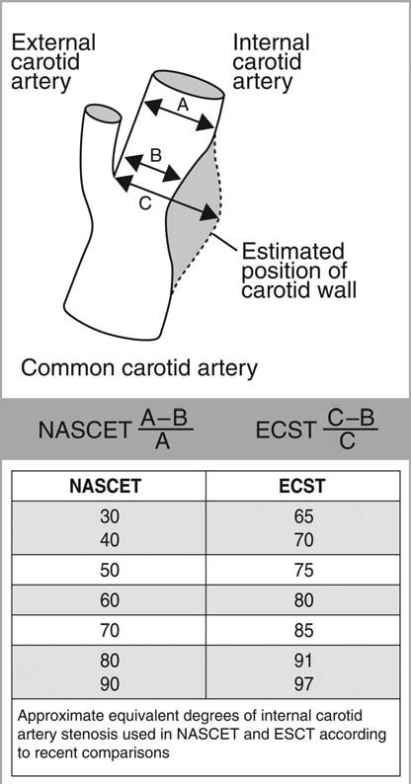
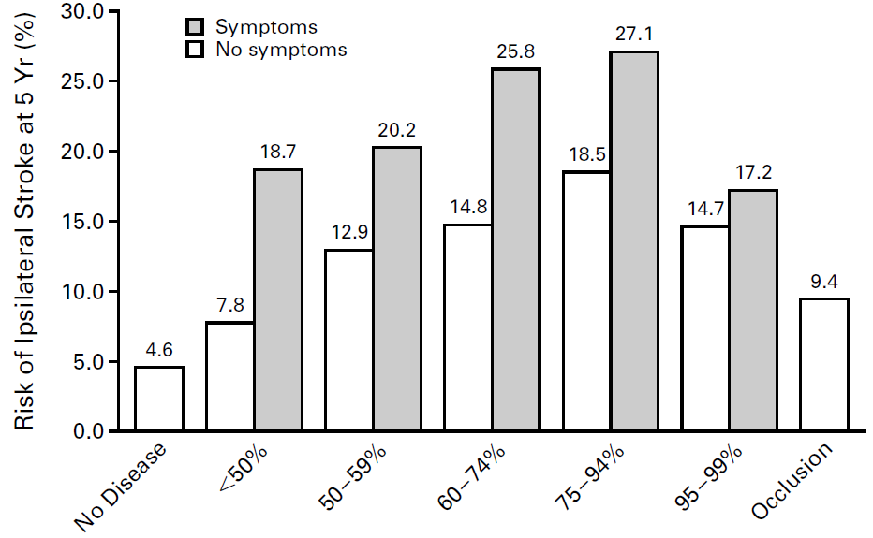
CARDIOCLUB
Why grading carotid stenoses?
The 5-Year Risk of a First Ipsilateral Stroke with and without Symptoms According to the Degree of Stenosis
Lancet 1989;351:1372-1373
N Engl J Med. 2000 Jun 8;342(23):1693-700

Slide 7
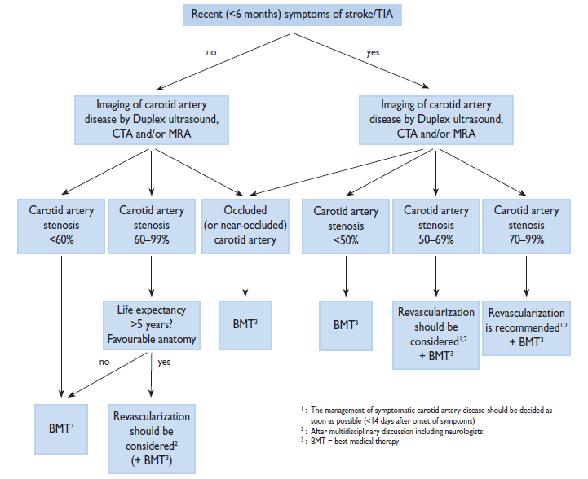
CARDIOCLUB
Management
Asymptomatic patients
Symptomatic patients
ESC PAD Guidelines. Eur Heart J. 2011 Nov;32(22):2851-906

Slide 8
CARDIOCLUB
Management I.
Asymptomatic patients
Symptomatic patients
ESC PAD Guidelines. Eur Heart J. 2011 Nov;32(22):2851-906

Slide 9
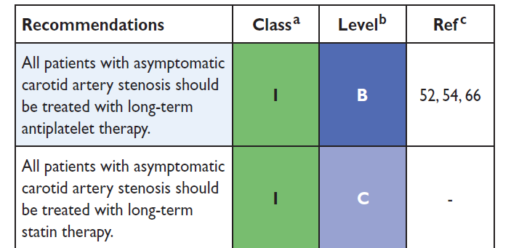
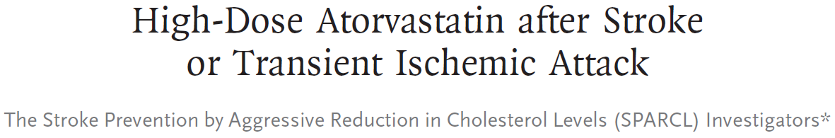
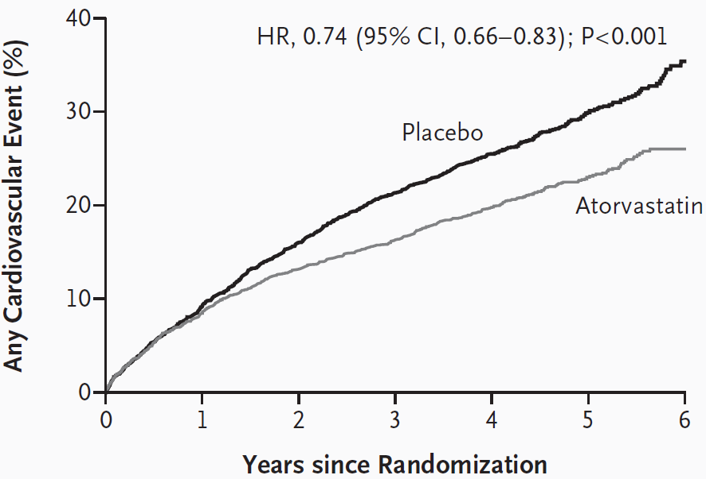
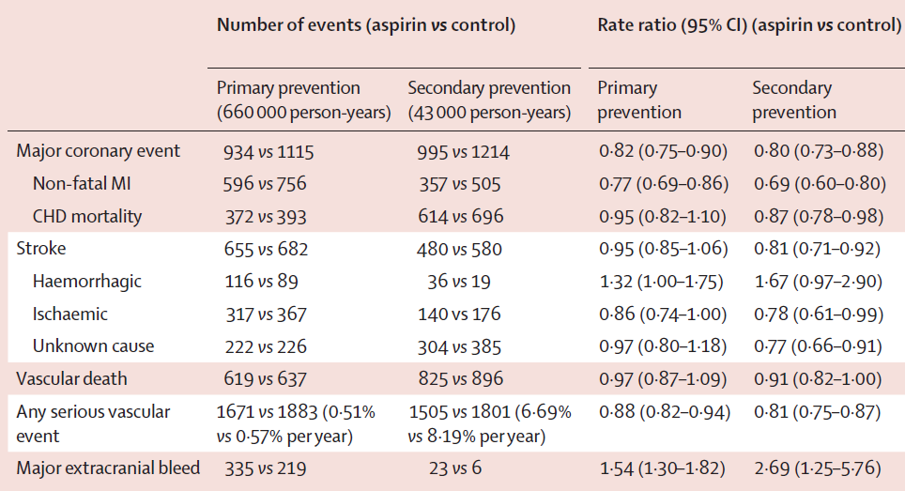
CARDIOCLUB
Best medical therapy
ESC PAD Guidelines. Eur Heart J. 2011 Nov;32(22):2851-906
“The effectiveness of statins in patients with symptomatic cerebrovascular disease is well proven, irrespective of the initial cholesterol concentration”
N Engl J Med 2006; 355:549-559
Lancet 2009; 373: 1849–60

Slide 10
CARDIOCLUB
Management II.
Asymptomatic patients
Symptomatic patients
ESC PAD Guidelines. Eur Heart J. 2011 Nov;32(22):2851-906

Slide 11
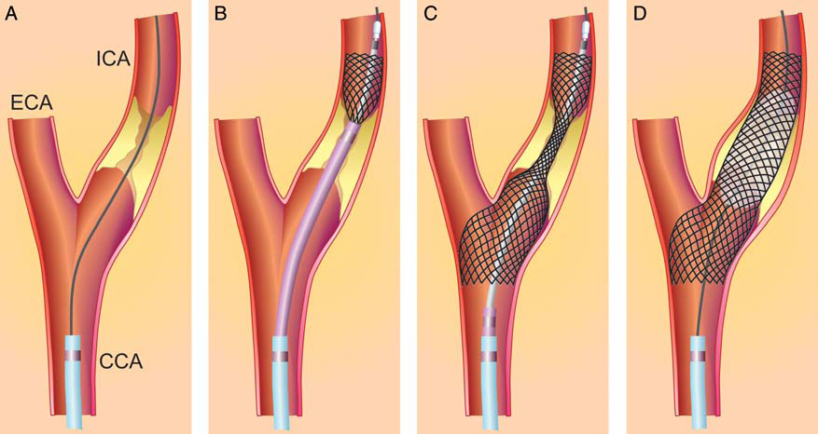
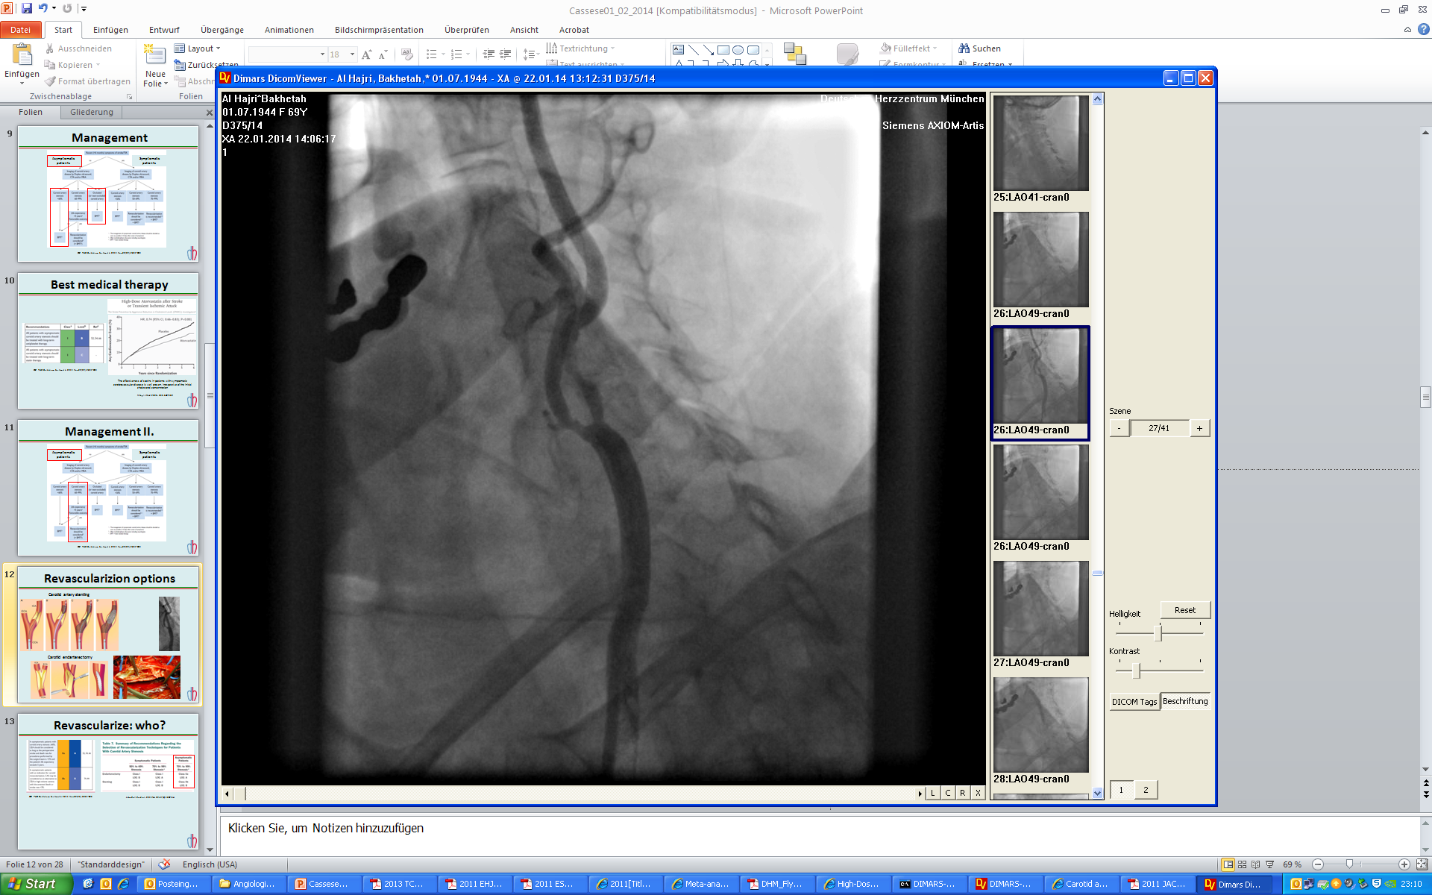
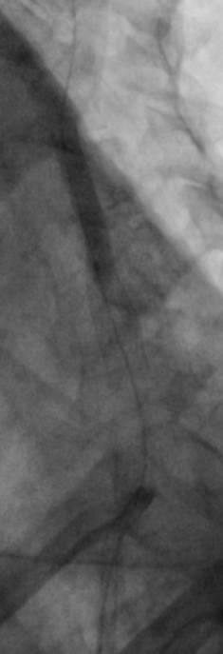
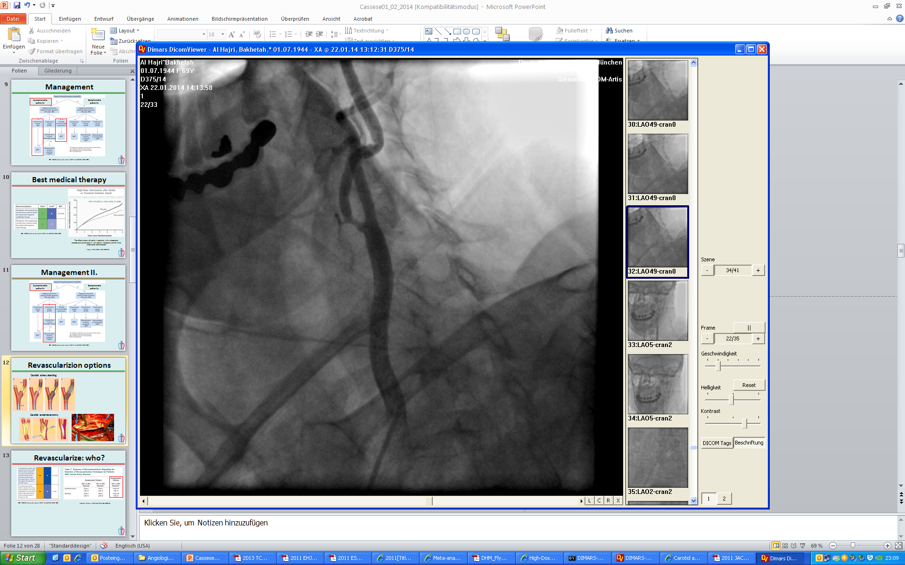
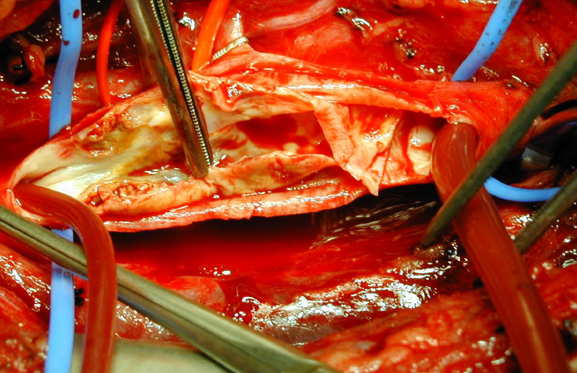
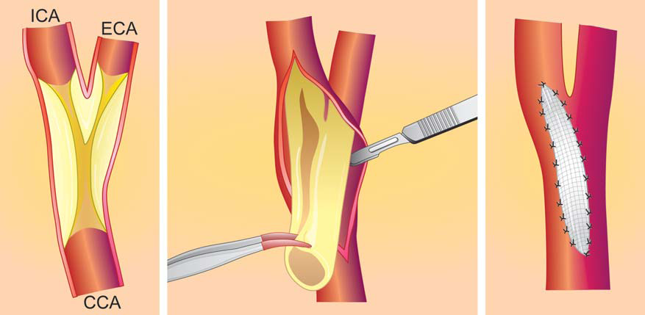
CARDIOCLUB
Revascularization options
Carotid artery stenting
Carotid endarterectomy

Slide 12
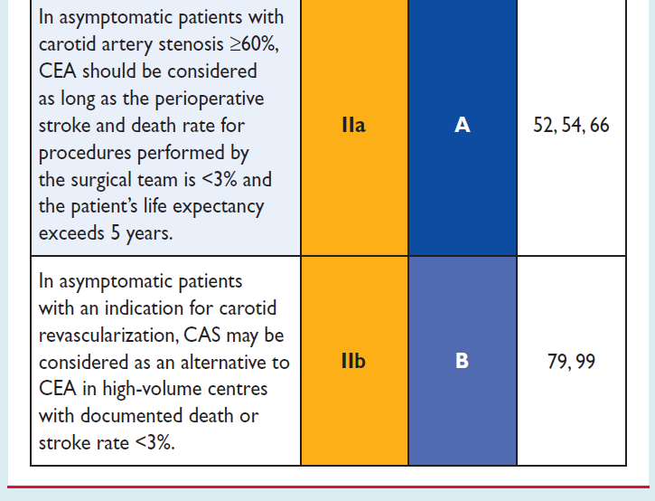
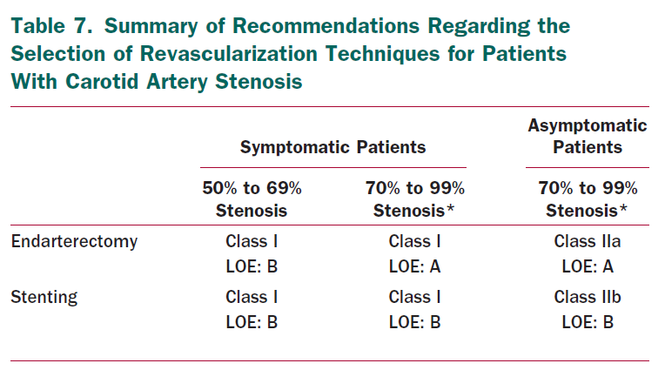
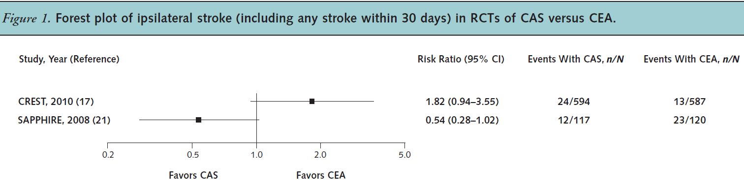
CARDIOCLUB
Revascularize: how?
ESC PAD Guidelines. Eur Heart J. 2011 Nov;32(22):2851-906
J Am Coll Cardiol. 2011 Feb 22;57(8):1002-44.
Ann Intern Med. 2013;158:676-685

Slide 13
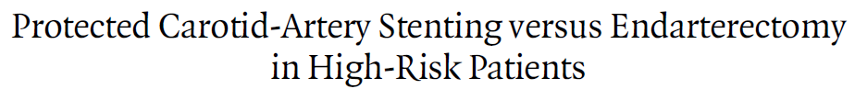
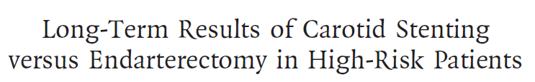
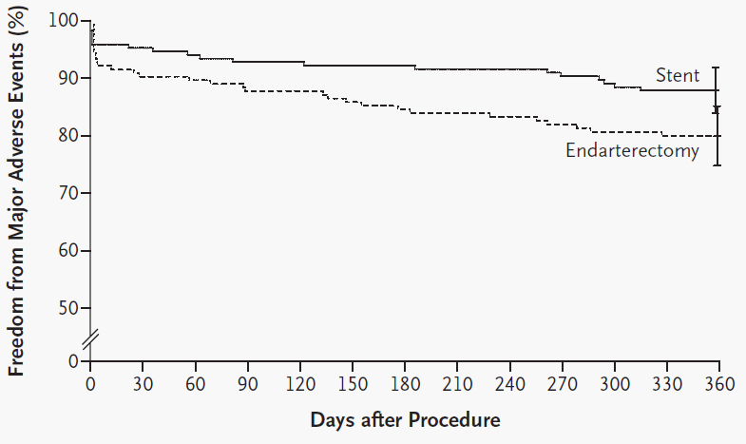
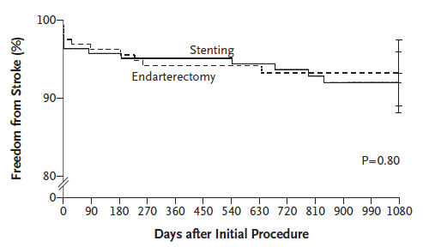
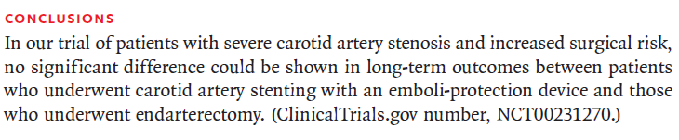
CARDIOCLUB
SAPPHIRE
MAE: Death, stroke, or myocardial infarction within 30 days after the intervention or death or ipsilateral stroke between 31 days and 1 year
ITT - CAS vs CEA (87.8 vs 79.9, P=0.053)
PPA - CAS vs CEA (88.0 vs 79.9, P=0.048)
N Engl J Med 2004;351:1493-501; N Engl J Med 2008;358:1572-9

Slide 14
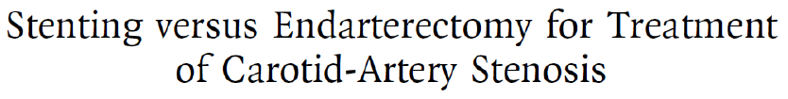
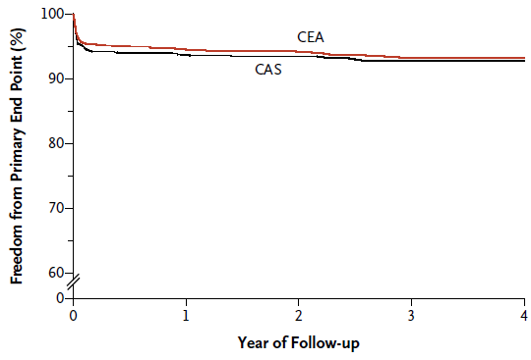
CARDIOCLUB
CREST
Primary endpoint stroke, MI, or any death during the periprocedural period or any ipsilateral stroke within 4 years after randomization
CAS vs CEA
HR 1.11 (0.81 to 1.51)
During the periprocedural period, there was a higher risk of stroke with CAS and a higher risk of MI with CEA
N Engl J Med. 2010 Jul 1;363(1):11-23

Slide 15
CARDIOCLUB
Management III.
Asymptomatic patients
Symptomatic patients
ESC PAD Guidelines. Eur Heart J. 2011 Nov;32(22):2851-906

Slide 16
CARDIOCLUB
Management IV.
Symptomatic patients
ESC PAD Guidelines. Eur Heart J. 2011 Nov;32(22):2851-906

Slide 17
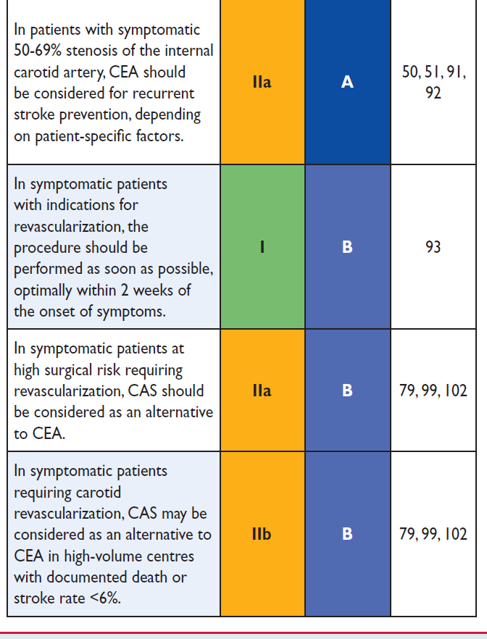
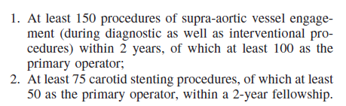
CARDIOCLUB
J Am Coll Cardiol. 2011 Feb 22;57(8):1002-44.
ESC PAD Guidelines. Eur Heart J. 2011 Nov;32(22):2851-906
Stroke. 2006;37:2400-2409

Slide 18
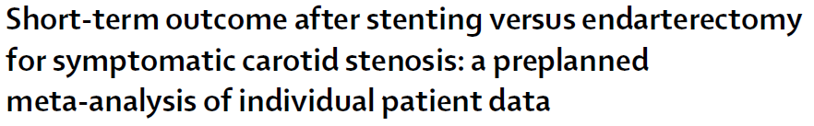
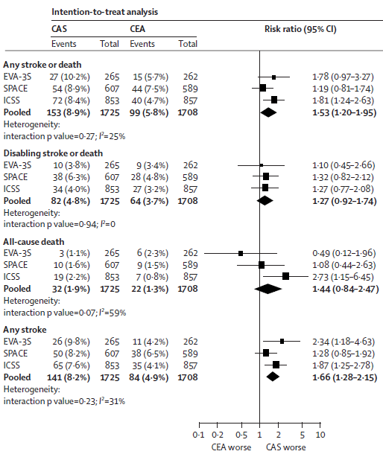
CARDIOCLUB
Lancet 2010; 376: 1062–73

Slide 19
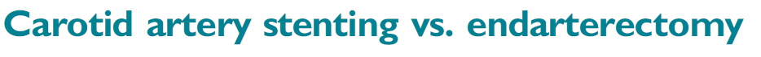
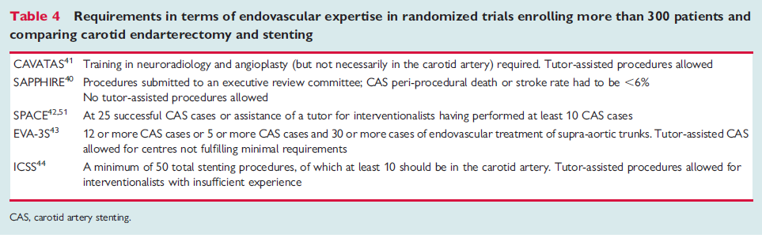
CARDIOCLUB
As a major limitation, the majority of the randomized studies had inadequate requirements in terms of endovascular expertise
Eur Heart J (2009) 30, 2693–2704
“The debate has been fuelled by the multiples medical specialties involved as well as by the disappointing results of CAS in randomized comparisons with CEA. While some have interpreted those findings as clear-cut clinical evidence, other have suggested that most of the trials may have compared the two revascularization modalities in an unfair way”
Eur Heart J 2015 Jan 1;36(1):13-21

Slide 20
CARDIOCLUB
Management V.
Asymptomatic patients
Symptomatic patients
ESC PAD Guidelines. Eur Heart J. 2011 Nov;32(22):2851-906

Slide 21
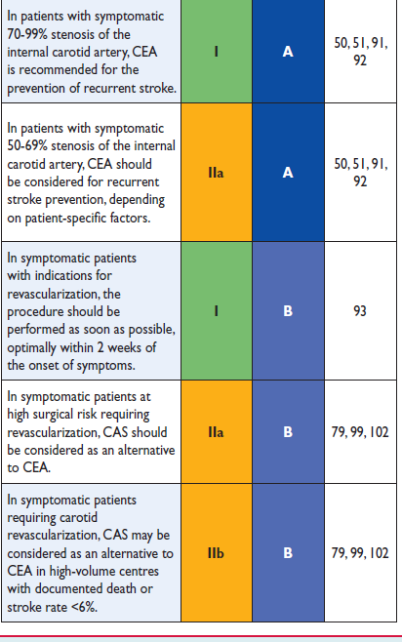
CARDIOCLUB
J Am Coll Cardiol. 2011 Feb 22;57(8):1002-44.
ESC PAD Guidelines. Eur Heart J. 2011 Nov;32(22):2851-906

Slide 22
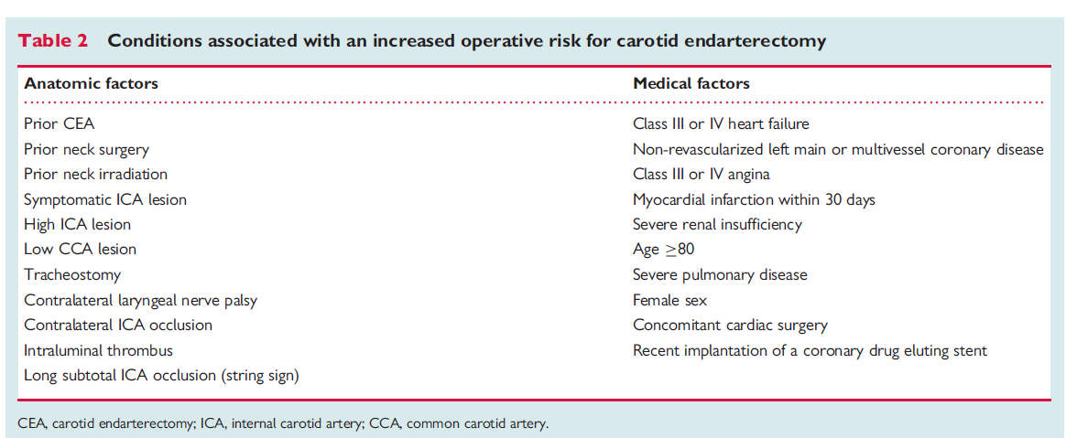
CARDIOCLUB
High-risk for CEA
Eur Heart J (2009) 30, 2693–2704

Slide 23
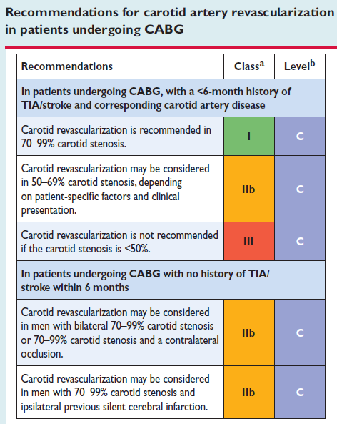
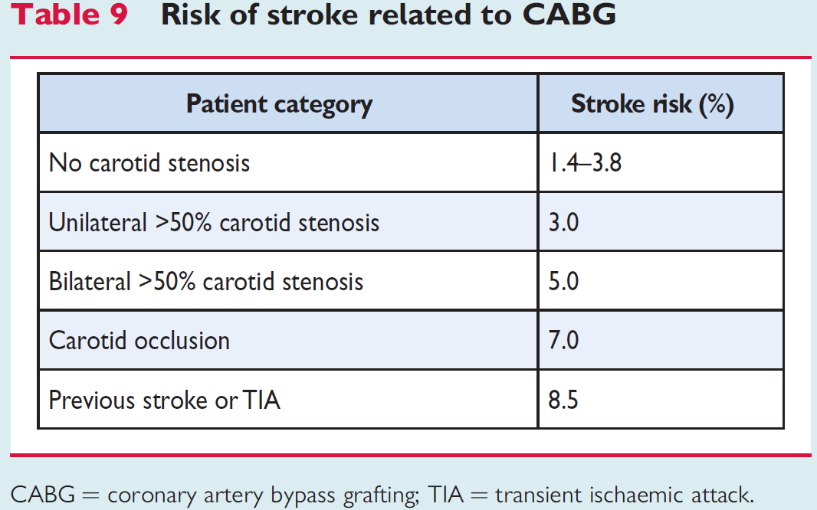
CARDIOCLUB
CAS and cardiac surgery
Mayo Clin Proc. 2004 Feb;79(2):223-9.
ESC PAD Guidelines. Eur Heart J. 2011 Nov;32(22):2851-906

Slide 24
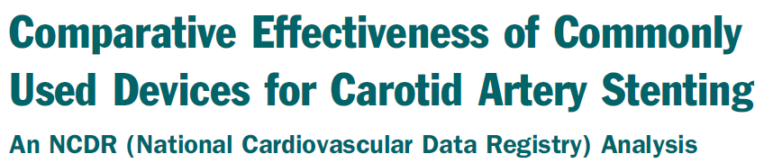
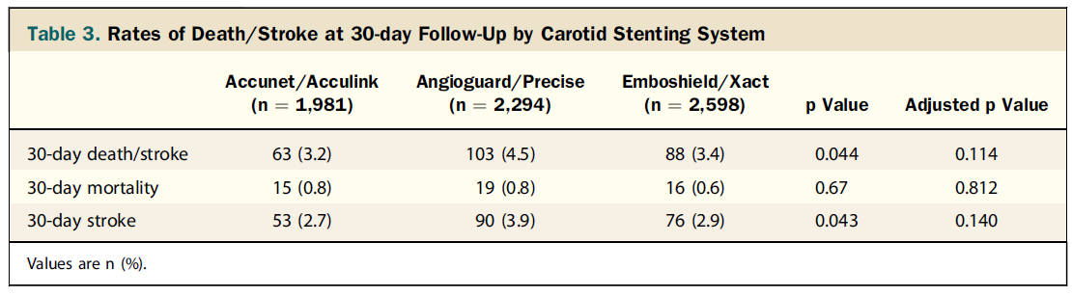
CARDIOCLUB
Contemporary CAS I.
A total of 12,135 consecutive carotid stent procedures included in the NCDR (National Cardiovascular Data Registry) CARE (Carotid Artery Revascularization and Endarterectomy) registry performed between January 1, 2007 and March 31, 2012
JACC Cardiovasc Interv. 2014 Feb;7(2):171-7

Slide 25

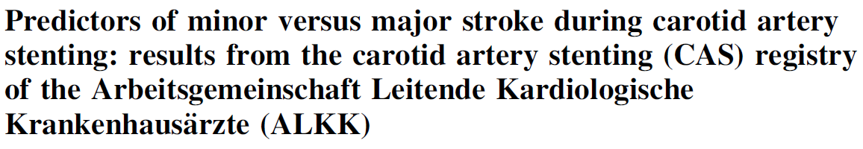
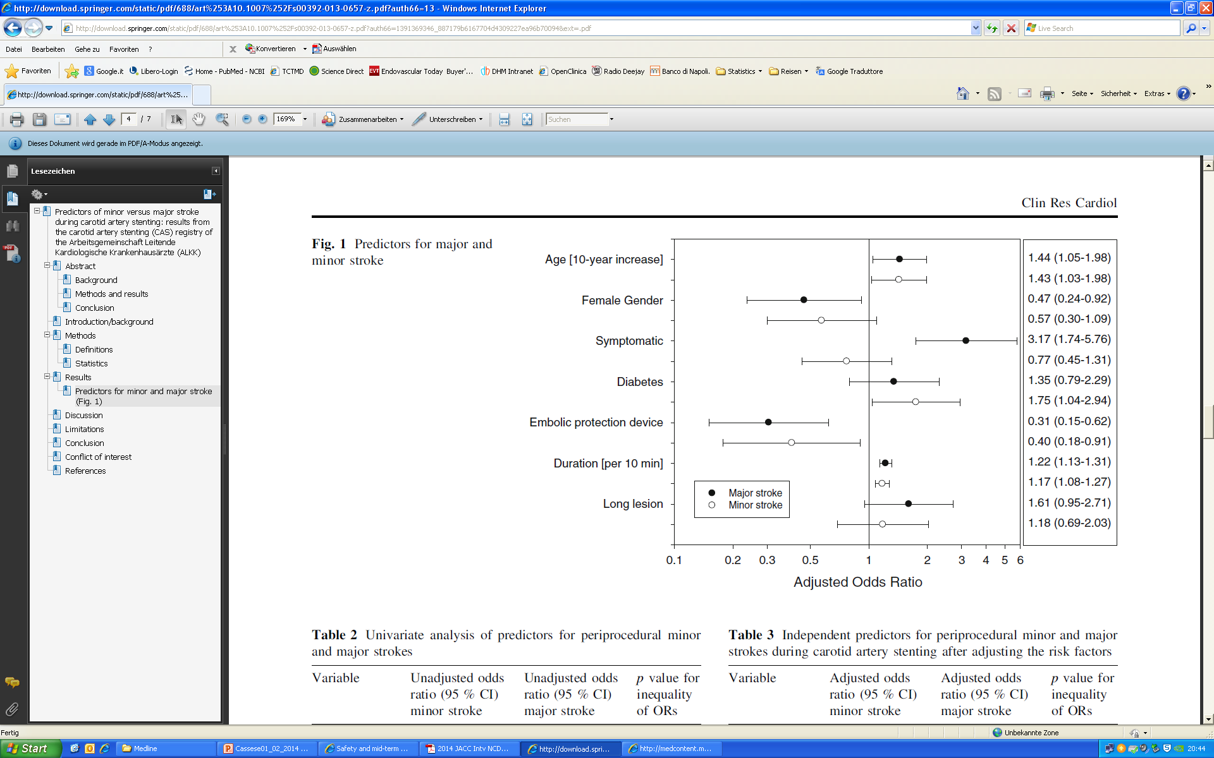
CARDIOCLUB
Contemporary CAS II.
From 1996 to January 2011, a total of 5,869 procedures were performed at 35 participating centers in Germany
Clin Res Cardiol. 2014 May;103(5):345-51

Slide 26
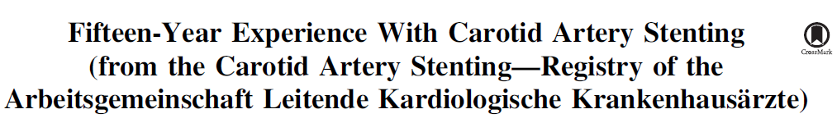
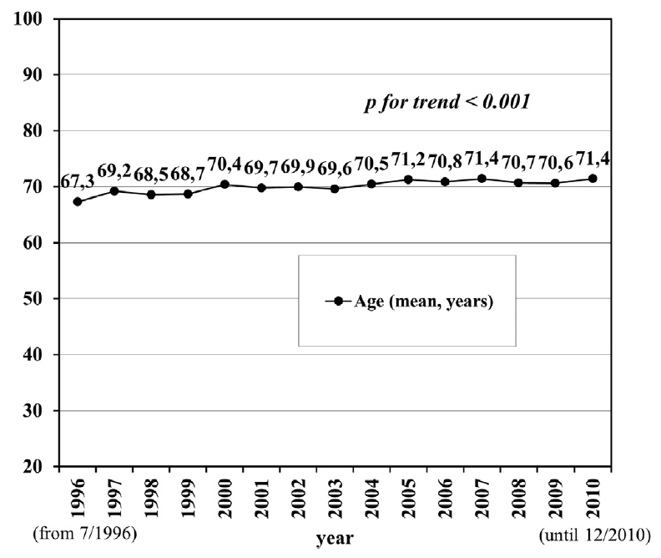
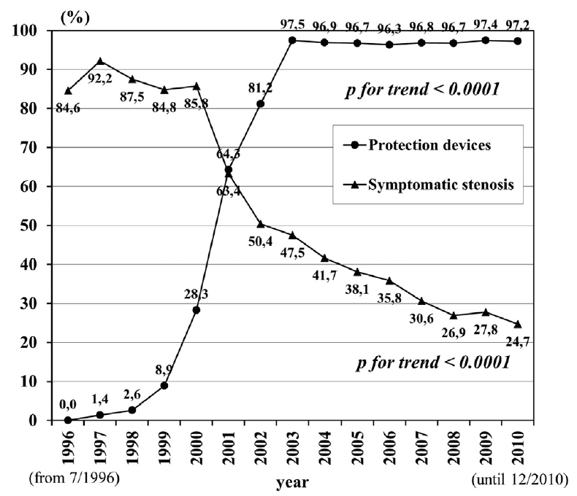
CARDIOCLUB
Contemporary CAS III.
Am J Cardiol 2015;115:360e366

Slide 27

CARDIOCLUB
Cerebral protection during CAS
ESC PAD Guidelines. Eur Heart J. 2011 Nov;32(22):2851-906

Slide 28



CARDIOCLUB
“One half of patients receiving protected CAS developed new embolic cerebral lesions at DW-MRI, although the overwhelming majority were asymptomatic.
Cerebral protection with PO versus DF neither reduced cerebral embolisation nor impacted on clinical outcomes. Diabetes, baseline stenosis and symptoms significantly modified the risk estimates for new cerebral lesions”
EuroIntervention 2015;10

Slide 29



CARDIOCLUB
Institutional CAS
Vasa 2013 May;42(3):196-207

Slide 30

CARDIOCLUB
EuroIntervention 2012;8:607-616

Slide 31

CARDIOCLUB
Configuration of the aortic arch
EuroIntervention 2010;5:866-870

Slide 32

CARDIOCLUB
Configuration of proximal vessel
EuroIntervention 2010;5:866-870

Slide 33

CARDIOCLUB
Configuration of stenting zone and distal vessels
EuroIntervention 2010;5:866-870

Slide 34

CARDIOCLUB
Configuration of cerebral vessels
EuroIntervention 2010;5:866-870

Slide 35
CARDIOCLUB
Conclusions I.
Patients suffering from atherosclerotic disease of carotid arteries represent an important challenge due to the high risk of disability and comorbidity
Pre-procedural imaging is pivotal in order to achieve supportive anatomical and functional informations before a carotid revascularization
Optimal medical management has an undisputed value in patients suffering from carotid artery disease and should be guaranteed to all patients regardless the revascularization options
In high-volume centers with documented low complication rate, patients with an indication for carotid revascularization can be successfully treated with CAS without the need for general anesthesia or neck dissection as compared with carotid endarterectomy

Slide 36
CARDIOCLUB
Conclusions II.
According to current evidence the relative efficacy of CAS versus CEA for patients with indication to carotid revascularization cannot be adequately assessed
However, the value of a multidisciplinary approach, as well as the necessity of high-level of expertise in performing carotid revascularization remains undebatable
In the next future, high-sensitivity imaging, new devices, advancement in anesthesia and surgery and more potent anti-atherosclerotic therapies will be of certain interest to shed more light on which patients will profit the most from aggressive management of carotid artery disease

Slide 37
CARDIOCLUB
vielen Dank für die Aufmerksamkeit

